Slide 1
Noncommunicable Diseases
Live Well: Foundations of High School Health
Chapter 1, Lesson 5

Slide 2
Write About It
What do you know about heart disease, cancer, or diabetes? Do you know anyone with any of these diseases?
Make a list of things you know about each of these diseases.

Slide 3
Can you . . .
Define what a noncommunicable disease is and give four examples?
Explain why most noncommunicable diseases are also chronic diseases?
Identify five behaviors that can contribute to a person’s risk of noncommunicable diseases?
Identify the signs of a heart attack?
Explain what a behavior contract is and how it helps individuals take responsibility for personal health behaviors?

Slide 4
Noncommunicable Disease
A noncommunicable disease is a disease that cannot be transmitted from one person to another.
These diseases often result from a combination of genetics and lifestyle factors.
Many noncommunicable diseases are chronic diseases. A chronic disease lasts three months or longer.

Slide 5
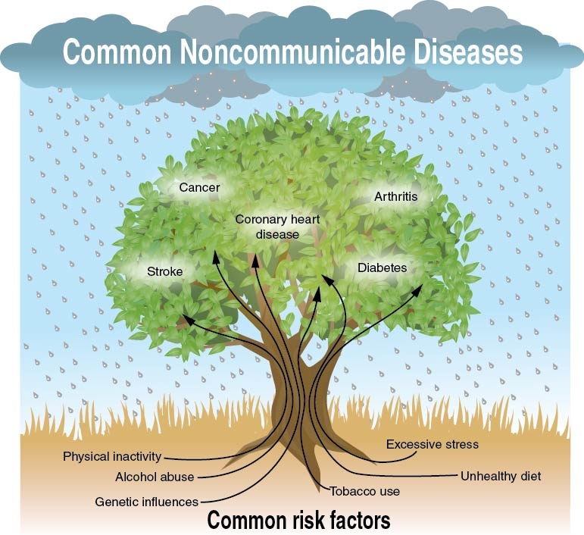
Noncommunicable Diseases and Risk Factors
Notes:
Figure 1.23 Noncommunicable diseases and risk factors.

Slide 6
Cardiovascular Disease
Coronary heart disease
  Atherosclerosis = clogged arteries
  Arteriosclerosis = hardened arteries
  Heart attack = loss of blood and oxygen to the heart
Stroke = loss of blood and oxygen to the brain
High blood pressure = increased pressure of blood in cardiovascular system

Slide 7
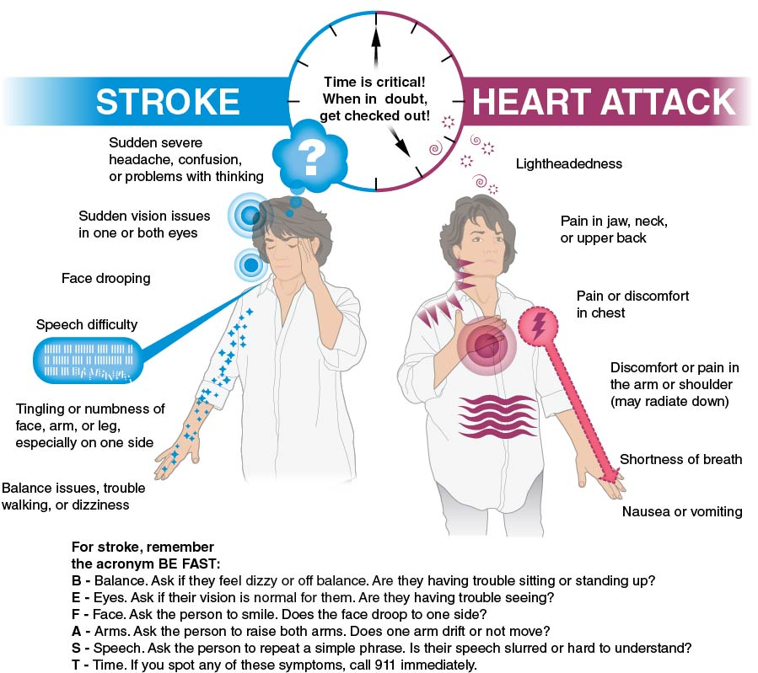
Warning Signs of Heart Attack and Stroke
Notes:
Figure 1.24 Signs of heart attack and stroke.

Slide 8
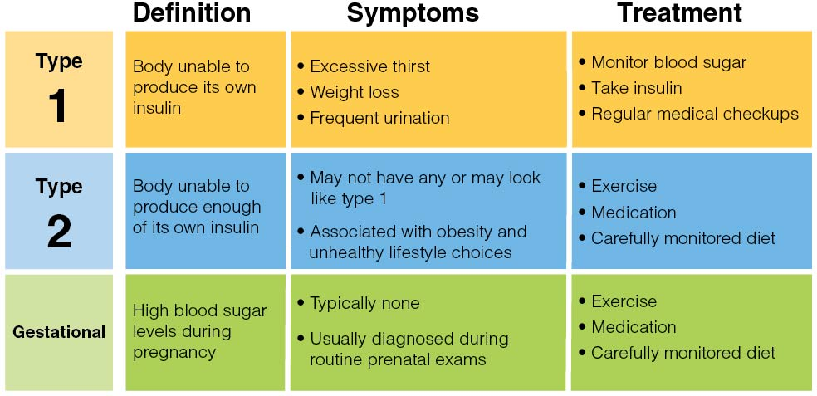
Diabetes
Notes:
Figure 1.25 Symptoms and treatments for the different types of diabetes.

Slide 9
Cancers
Cancer is the uncontrolled growth of abnormal cells in the body.
Common types of cancer include the following:
  Breast cancer
  Colon cancer
  Leukemia
  Lung cancer
  Melanoma
  Prostate cancer

Slide 10
Preventing Skin Cancer
Seek shade, especially at middle of the day.
Wear clothing that covers and protects your skin, such as hats and long sleeves.
Wear a hat with a wide brim to protect neck, ears, and face.
Wear sunglasses that block UVA (long-wave) and UVB (short-wave) sun rays.
Use sunscreen with a sun protection factor (SPF) of at least 15.
Avoid tanning indoors or outdoors.

Slide 11
Osteoporosis
Osteoporosis is a chronic disease marked by weakening of the bones.
  It occurs when the body no longer makes new bone, loses existing bone, or both.
  Caucasian women are at highest risk.
  Teenagers with eating disorders are at higher risk later in life.

Slide 12
Arthritis and Lung Disease
Arthritis = swelling and damage to joints
  Over 100 different types exist.
  Exercise, diet, and medications can help manage arthritis.
Lung disease = a variety of conditions that affect ability to breathe and use oxygen
  Asthma, or inflammation of the lungs, is one common form of lung disease.
  Chronic obstructed pulmonary disease (COPD) involves difficulty in exhaling air from the lungs.

Slide 13
Alzheimer’s and Dementia
Dementia = a loss of brain function over time
Alzheimer's disease = the most common form of dementia
  Alzheimer’s disease is more common among women.
  High blood pressure or past head trauma increase risk.

Slide 14
Behavior Contracts
A behavior contract is an agreement you make with yourself to change a specific health behavior.
A behavior contract includes the following:
  Goals
  Deadlines (dates)
  A plan or strategy to complete goals
  A reward for completing goals
Most behavior contracts are witnessed, or signed by, someone else.

Slide 15
Skill-Building Challenge
(1 of 2)
Think about behaviors that help to prevent noncommunicable diseases. Select one that you struggle to do and complete the following contract to help you make a change.
I, _____, have decided to change the following health behavior: _____.
My goal is to _____. (insert SMART goal)
I will achieve my goal by _____. (insert date)
(continued)

Slide 16
Skill-Building Challenge
(2 of 2)
4. I want to change this behavior is because _____.
5. I think it will be hard to change this behavior because _____.
6. The specific steps or actions I will take to help me meet my goal are _____.
7. If I achieve my goal, I will reward myself by _____.
8. I will review this contract on _____. (future date)

