Slide 1
Personal Health Habits
Live Well: Foundations of High School Health
Chapter 2, Lesson 1

Slide 2
Write About It
Have you ever used technology to improve the look of your hair or skin on an image? If so, explain the situation.
What were you trying to achieve?
If you haven’t done this, why do you think you haven’t? Do you think you might in the future?

Slide 3
Can you . . .
Define what hygiene is and explain why it is important?
Understand the anatomy of the skin, hair, and nails?
Identify common problems with skin, hair, nails, and teeth?
Evaluate the effects media have on our decisions about skin and hair care?

Slide 4
Developing Good Hygiene
It is important to practice good hygiene if you want to stay healthy.
Hygiene is the practice of keeping yourself in good health by maintaining your personal cleanliness.
  Brushing your teeth
  Washing your face and hands
  Showering
  Trimming your toenails

Slide 5
Your Skin
Your skin is the largest organ you have.
It plays an important role in keeping you healthy.
  Provides a barrier to all sorts of pathogens in the environment
  Helps to protect every other organ in your body
  Keeps your body temperature normal

Slide 6
Layers of the Skin (1 of 2)
Your skin comprises three layers.
The outer layer is called the epidermis.
  It functions to protect you from the environment.
  It contains melanin, the cells that give skin its color.
The middle layer is called the dermis.
  It contains the hairs you see on your skin.
  It contains sweat glands, blood vessels, and nerves.
The inner layer is called the hypodermis.
  It contains blood vessels, fat, and more nerves.
  It connects the skin to muscles and bones underneath.
  (continued)

Slide 7
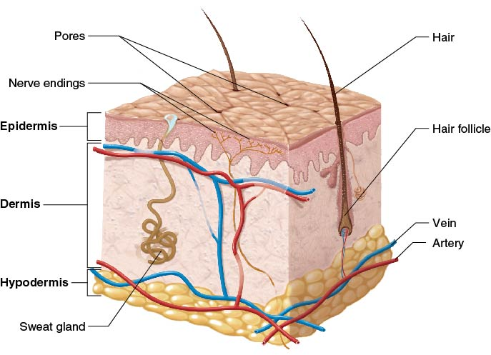
Layers of the Skin (2 of 2)
Notes:
Figure 2.1 Layers of the skin.

Slide 8
Caring for Your Skin
Your skin is a part of your body, and it responds to the choices you make.
Skin is healthiest when you drink plenty of water, eat a healthy diet, and get regular physical activity.
Smoking, exposure to a lot of sunlight, and stress can make the skin less healthy.

Slide 9
Recognizing and Treating Common Skin Problems (1 of 2)
Acne
  A collection of pimples that forms on the face, neck, back, chest, and shoulders
  Caused when oil-making glands and skin cells form a plug and the area becomes infected
  Results from hormone changes and hygiene practices
  Treatments: keeping skin clean, medication
Eczema, or dermatitis
  Typically causes dry, itchy skin and rashes on the face, inside the elbows and behind the knees, and on the hands and feet
  Treatments: medication, skin creams, light therapy
  (continued)

Slide 10
Recognizing and Treating Common Skin Problems (2 of 2)
• Sunburn
  Makes the skin turn red and hot to the touch
  Can cause dry or wrinkled skin, dark spots, and skin cancers, such as melanoma
  Prevention: limit exposure to sun; wear protective gear, clothing, and sunscreen

Slide 11
Detecting Skin Cancer
Skin cancer is the most common cancer in the United States.
Performing regular skin checks can help you detect skin cancer early.
When you do a skin check
  pay attention to all areas of the body,
  check for any changes in your skin, and
  use mirrors to help you check hard-to-see areas.
Most skin cancer is treatable with early detection.

Slide 12
Your Hair and Nails
Hair grows all over your body except on your lips, palms, and the soles of your feet.
  Hair helps keep you warm and protects the eyes, ears, and nose from small particles in the air.
Nails are composed of a hard form of protein called keratin.
  Healthy nails are usually smooth and consistent in color.
  When nails become discolored or have big pits on them, it can be a sign of other diseases.

Slide 13
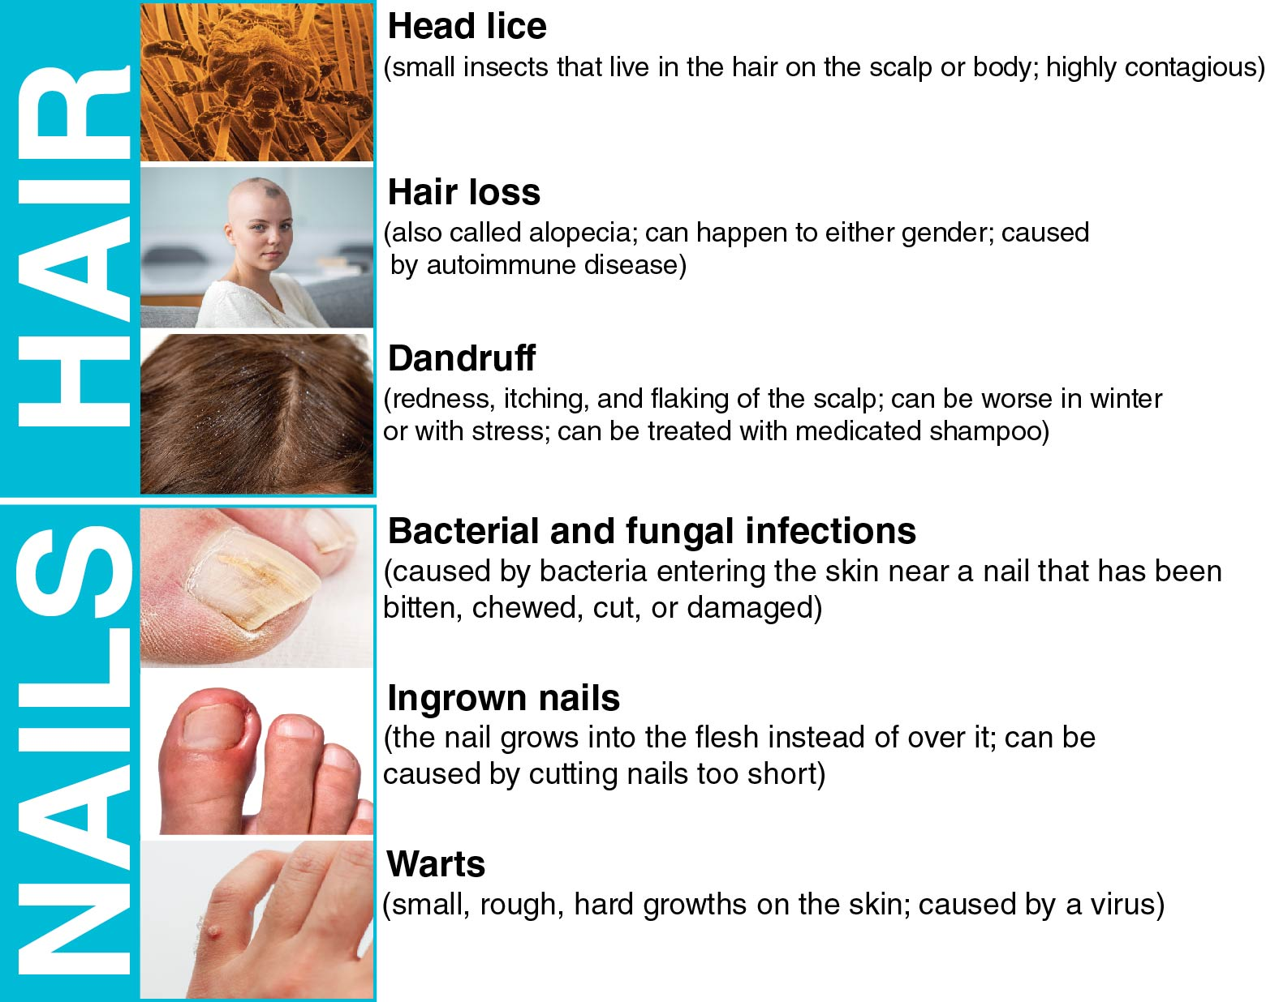
Common Hair and Nail Problems
Notes:
Figure 2.4 You are likely to experience one or more of these common hair or nail problems in your lifetime.

Slide 14
Common Problems With the Mouth and Teeth
Crooked or crowded teeth
  May cause pain in the jaw or frequent headaches
Tooth decay
  Causes a cavity, or hole, that can destroy the tooth
Gum disease
  Caused by a buildup of plaque and tartar
  Can lead to gingivitis, or inflammation of the gums
Cold sores
  Caused by the herpes simplex virus (HSP)
  Are contagious and can be spread by kissing

Slide 15
Analyzing Influences: Beauty, Media, and Technology
Today’s technology allows us to change photos of people in a lot of ways.
Almost all media images have been changed to look more attractive or appealing.
  Hair and skin are two of the most commonly altered parts of photos.
It is important to realize that technology makes it very easy for the media to show unrealistic images.

Slide 16
Skill-Building Challenge
Make a list of three different social media and traditional media sources you use on a regular basis.
For each source, reflect on how you feel and act after you’ve been using that source.
How does each source affect your own self-image?

