Slide 1
Healthy Vision and Hearing
Live Well: Foundations of High School Health
Chapter 2, Lesson 2

Slide 2
Write About It
How many hours did you spend wearing earbuds or headphones this week?
How many hours did you spend looking at a screen (your phone, television, tablet, computer)?
How do you think these behaviors affect the long-term health of your eyes and ears?

Slide 3
Can you . . .
Explain how vision works?
Compare nearsightedness and farsightedness?
Describe what eye strain is and explain how to help reduce it?
Analyze how earbuds and headphones might contribute to hearing loss?
Analyze how perception of norms influence vision and hearing behaviors?

Slide 4
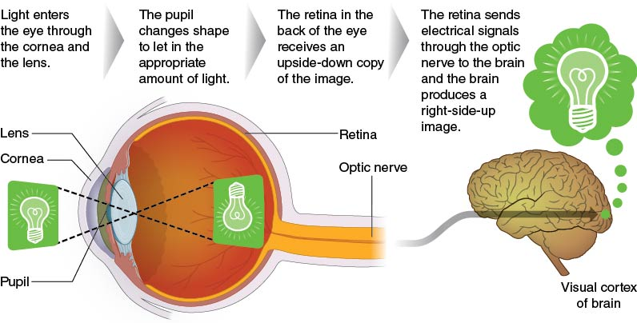
Your Eyes and How You See
Your eyes function similarly to how the camera on your cell phone works.
Notes:
Figure 2.8 Anatomy of the eye and how the eye works.

Slide 5
Protecting Your Vision (1 of 2)
Whenever you are outside in the sun, it is important to wear sunglasses.
Good sunglasses will protect your eyes from any flying debris in the air (such as bugs, dirt, and gravel).
They will also protect your eyes from harmful ultraviolet (UV) rays that can damage the shape of the cornea.
(continued)

Slide 6
Protecting Your Vision (2 of 2)
Eye strain is a form of fatigue that happens to your eyes when they have to focus on a close-up object for long periods of time (for example, a computer screen).
The best treatment for eye strain is to cut back on the hours of screen time you have each day.
Symptoms of eye strain include blurred vision; double vision; dry, red eyes; eye irritation; headaches; and neck or back pain.

Slide 7
Common Problems With Vision (1 of 2)
Nearsightedness (myopia)
Can see objects that are up close clearly but have a harder time seeing objects in the distance
Farsightedness (hyperopia)
A condition where light focuses behind the retina and objects that are up close are hard to see clearly
Astigmatism
Occurs when light is not focused evenly on the retina, making objects appear blurry or distorted
(continued)

Slide 8
Common Problems With Vision (2 of 2)
Presbyopia
Happens when eye lens becomes stiffer; light isn't focused as well, so close-up objects are harder to see.
Color blindness
A color vision deficiency that keeps a person from seeing colors in the way most people do
Red or bloodshot eyes
Blood vessels that expand when irritated or infected
Night blindness
A condition in which a person has a hard time seeing in the dark

Slide 9
Your Ears and How You Hear (1 of 2)
Your hearing allows you to listen to your favorite music, dance, and talk to your friends and maintains your equilibrium, or balance.
Your ears are very complex organs that help you take in sound waves from the environment and convert them into things you recognize.
Your ear drum vibrates the sound waves into the middle ear, where three small bones further vibrate the sound waves into the cochlea in the inner ear.
(continued)

Slide 10
Your Ears and How You Hear (2 of 2)
Notes:
Figure 2.10 Anatomy of the ear.

Slide 11
Protecting Your Hearing (1 of 2)
Avoid very high levels of noise, such as rock concerts or similar situations. If you do need to be in these situations, protect your ears.
Do not stick objects into your ears because you might puncture or damage the eardrum. This includes cotton-tipped swabs. Clean only the outside of your ears.
Regular medical exams include inspection of the ears for earwax or signs of infection. Safe medicines can be used to clean and heal the ear.
(continued)

Slide 12
Protecting Your Hearing (2 of 2)
If you lose all or part of your hearing, it is unlikely that you will ever get it back.
Most hearing loss is permanent.
Hearing aids can help restore some hearing in many situations.

Slide 13
Common Problems With Hearing
Conductive hearing loss: caused by sound not being transmitted into the inner ear
Often due to damage to the eardrum, such as a rupture or tear
Sensorineural hearing loss: caused when sound information is not passed from the inner ear to the brain properly
Caused by damage to the auditory nerve
Tinnitus: caused by damage to some part of the middle or inner ear
A ringing, buzzing, or other sound in the ear

Slide 14
Social Norms and Listening Behaviors
Social norms (going everywhere with a cell phone, earbuds in ears most of the day) act like unofficial rules or laws. They influence us because we want to fit into a particular social group.
Social norms may keep people from talking about, protecting themselves from, or seeking help for vision or hearing problems.
We can limit harmful social norms by developing empathy, an understanding and appreciation of others’ feelings.

Slide 15
Skill-Building Challenge
Analyze how technology, media, and social norms can influence your vision and hearing behaviors. Often, we make choices based on a desire to be liked or popular, even when those choices negatively influence our health.
On the teacher handout, fill in the outer area of the rectangle with as many influences or social norms as you can think of.
On the inside of the rectangle, write a short paragraph about how these influences affect your behaviors.

