Slide 1
Understanding Health Equity
Live Well: Foundations of High School Health
Chapter 3, Lesson 1

Slide 2
Write About It
Do you think you have the same access to services and opportunities as other people you know when it comes to things that might influence your health? Explain your response.

Slide 3
Can you . . .
Explain what health equity is?
Compare and contrast the concepts of equity and equality?
Describe the major social and economic influences on health?
Define health disparities and explain how they relate to health equity?

Slide 4
Health Equity
Health equity occurs when everyone has the opportunity to attain full health and wellness and no one is disadvantaged because of their social position or other socially defined circumstances.
  Health equity is not the same as equality.
  Equity refers to providing all people equal access and opportunity to achieve good health and quality of life.
  Equality would mean that all people end up with the same health status or outcome, which is not a realistic health goal.

Slide 5
Achieving Health Equity
Health equity is essential to building a productive and vibrant community and society.
Achieving health equity as a society requires the following:
  Creating a culture of health, with a common understanding and shared systems for good health
  Attending to the source of health inequities, such as affordable housing and access to quality, free education
  Measuring the effect that socioeconomic factors have on health outcomes

Slide 6
Socioecological Model of Health (1 of 3)
The socioecological model of health provides a way for us to think about things we may not personally control but that influence our health.
For example, when thinking about how health equity issues influence a person’s nutrition and physical activity, we could consider the following:
  Individual preferences and choices in diet
  Interpersonal influences, such as peer pressures, family dietary habits and practices, access to youth sport experiences, and social expectations on weight and aging
  Community influences, such as access to farmers’ markets, trails and parks, healthy food options, and community events that support healthy living
  (continued)

Slide 7
Socioecological Model of Health (2 of 3)
  Institutional influences like school meal access and quality; recess and physical education policies; access to free community centers, sports, and activities; and neighborhood grocery store access and food supply
  Policy influences like access to government-assisted food programs, taxes on junk foods or soft drinks, food labeling regulations, government agricultural subsidies that influence access and affordability of specific foods, and community planning and tax-based support for developing and maintaining parks and recreation and public lands
  (continued)

Slide 8
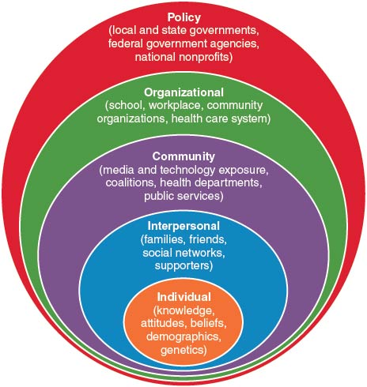
Socioecological Model of Health (3 of 3)
Notes:
Figure 3.2 Socioecological model of health.

Slide 9
Health Disparities (1 of 2)
The goal of health equity is to reduce or eliminate actual health disparities.
A health disparity refers to preventable differences in health status that are linked with social, economic, and environmental disadvantage.
  Health disparities occur across socioeconomic status, age, geography, language, sex, and disability status.
  Differences also occur within groups.
  (continued)

Slide 10
Health Disparities (2 of 2)
Examples of health disparities in the United States include the following:
  Infant mortality. Babies born to Black women in the United States are more than two times as likely to die as babies born to White women.
  Cancer. Individuals with lower incomes and education levels are more likely to get cancer and die from it than their more affluent peers.
  Dementia. Black people have the highest risk for dementia and are twice as likely as White people to develop Alzheimer’s disease.

Slide 11
Impact of Health Disparities
Health disparities can affect individuals, families, and communities and can persist across generations.
The following are impacts of health disparities:
  Parents who might be too sick to work become low-income.
  Unemployed, low-income people are less likely to have access to health insurance. They are more likely to avoid medical care and get sicker.
  Children raised in poverty are less likely to persist in school or go to college, leaving them mired in poverty.

Slide 12
Eliminating Health Disparities
U.S. government policies and efforts designed to reduce health disparities focus on designated priority populations and marginalized groups.
  These groups and populations include people of color, women, children, older adults, and those with special health care needs.
  No single approach will work to eliminate all health inequities and disparities.
  Addressing disparities in health and health care is important to improving the nation’s overall health, workforce, and economic prosperity.

Slide 13
Skill-Building Challenge
Use the socioecological model to analyze influences on your health. Explain how individual, interpersonal, community, organizational, and policy influences might affect your health status related to your
  physical activity,
  diet,
  mental health, and
  social health.

