Slide 1
Public Health
Live Well: Foundations of High School Health
Chapter 3, Lesson 3

Slide 2
Write About It
What experiences do you have with public health services or organizations?
Describe your experience in your response.

Slide 3
Can you . . .
Use examples to explain public and community health services?
Explain how public health influences you individually?
Describe two careers related to public health?
Compare and contrast the three different levels of prevention?
Advocate for public health services?

Slide 4
Public Health and Community Health
Public health is the art and science of protecting and improving the health of individuals and large populations.
Public health happens at the national, regional, state, and local levels.
Community health is a form of public health focused on a particular group of people or geographical area. It tries to bring the greatest health benefits to the greatest number of people.

Slide 5
Public Health Activities (1 of 2)
Public health involves many activities:
  Educating people: Examples include public service announcements, educational websites, community safety, and first aid classes.
  Investigating outbreaks: Examples include diseases carried in the food supply, like salmonella, and contagious disease outbreaks, like COVID-19.
  Monitoring communities: Examples include tracking rates of injury, illness, and disease in a community.
  Developing policies: Examples include setting required vaccinations for school attendance.
(continued)

Slide 6
Public Health Activities (2 of 2)
  Enforcing laws: Examples include enforcing food handling and serving laws in restaurants.
  Conducting research: Examples include researching connections between pollution and cancer risk.
  Responding to disasters: Examples include organizing assistance to survivors after a natural disaster, like a hurricane, or an outbreak of violence.
  Providing preventive services: Examples include providing free or reduced-cost vaccination clinics.
  Providing accessible services: Examples include providing free treatment for drug addiction.

Slide 7
Community and Public Health Resources
Public health resources exist at different levels and provide different services.
The major government provider of public health oversight in the United States is the Centers for Disease Control and Prevention (CDC).
  The CDC is part of the Department of Health and Human Services.
  The CDC website maintains current, factually accurate public health information on a wide range of topics.
Other government and nongovernment agencies also provide public health services.

Slide 8
Government and Nongovernment Public
Health Organizations
Examples of Government and Nongovernment Public Health Organizations
Government agencies | Nongovernment agencies
Centers for Disease Control and Prevention Health and Human Services National Institutes of Health Indian Health Services Food and Drug Administration Division of Adolescent and School Health State health departments Local health departments City health departments | World Health Organization American Public Health Organization Doctors Without Borders World Bank The Carter Center Bill and Melinda Gates Foundation American Red Cross National Kidney Foundation

Slide 9
Global Issues and Public Health (1 of 2)
Global public health examines the issues that affect the health of people around the world.
  Global public health is focused most often on preventing illness and disease, but it also includes traditional areas of medicine and rehabilitation.
  Many global health efforts are focused on the poorest and most underserved populations.
  Global health is important because we live in a mobile society. When people travel to other countries, they are vulnerable to the diseases and risks in that country.
  (continued)

Slide 10
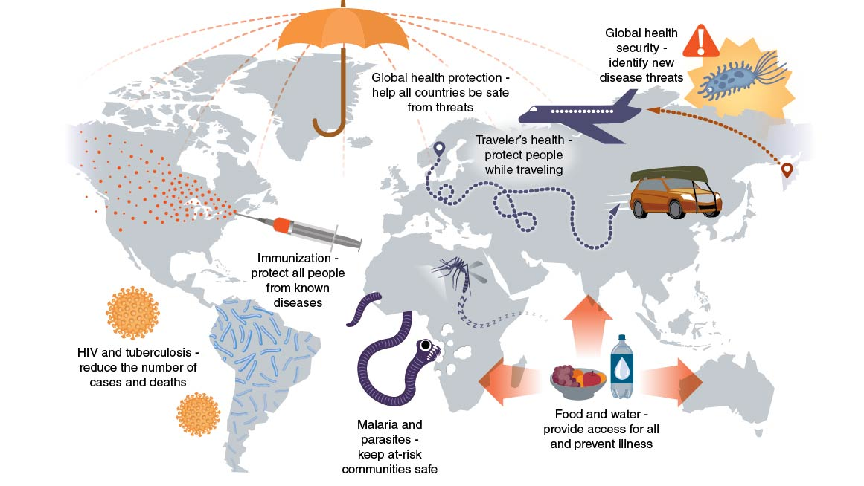
Global Issues and Public Health (2 of 2)
Notes:
Figure 3.5 Major global health issues.

Slide 11
Health Promotion and Prevention (1 of 2)
Public health efforts fall into three categories based on the type of prevention they seek: primary, secondary, and tertiary.
  Primary prevention includes actions and services that reduce risk and avoid health problems.
  Secondary prevention involves recognizing risks for (or beginnings of) problems and intervening before serious illness or effects arise.
  Tertiary prevention involves treatment and rehabilitation of a person who is already sick. It is best thought of as prevention of death.
  (continued)

Slide 12
Health Promotion and Prevention (2 of 2)
One major public health goal is to reduce both the incidence and the prevalence of disease and disability.
  Incidence refers to the number of new cases that occur in a year.
  Prevalence refers to the number of existing cases.
Public health workers called epidemiologists track both the incidence and prevalence of diseases, disabilities, and related health behaviors.

Slide 13
Careers in Community and Public Health (1 of 2)
Health care is the largest employment category in the United States. Health care includes providers like doctors, dentists, and nurses.
Public and community health care workers are also a part of the health care industry.
A wide range of jobs are available in public and community health. Most of these jobs require at least an undergraduate college degree, and many require graduate education.
(continued)

Slide 14
Careers in Community and Public Health (2 of 2)
Career | Description | Requirements
Epidemiologist | Researches and investigates patterns of disease | Typically at least a master’s degree in public health or a related field
Social worker | Provides counseling and assistance to people in need (e.g., children, veterans, older adults, people experiencing homelessness) | A minimum of a bachelor’s degree from an accredited social work program
Public health nurse | Focuses on working to improve the health of a specific group or community | A minimum of a bachelor’s degree in nursing
Microbiologist | Researches microorganisms with the goal of developing drugs to fight infectious diseases | A bachelor’s degree in microbiology to enter the field and a PhD to work as a researcher or at a college or university
Public health educator | Provides education to a community in order to promote health or prevent the spread of disease | A minimum of a bachelor’s degree in health education or public health
Public health analyst | Gathers and tracks data about public health activities and programs to determine their effectiveness | A minimum of a bachelor’s degree in public health, health analytics, or a related field
Health inspector | Ensures that state laws and sanitary codes are followed in a community | Varied pathways including on-the-job training (technicians) and a bachelor’s degree in occupational health and safety (specialists)

Slide 15
Skill-Building Challenge
Use the Internet to find three to five different resources in your community that relate to public health.
Write down the name of each resource and describe what services it provides. Record a phone number, email address, or web address for each resource you find. The following are examples:
  Public health department for your city or county
  Local chapters of the American Red Cross or the American Heart Association
  Women’s and children’s health clinics

