Slide 1
Understanding Foods and
Nutrients
Live Well: Foundations of High School Health
Chapter 4, Lesson 1

Slide 2
Write About It
What do you drink when you are thirsty, and how do you decide what to drink?
Explain your answer using three different circumstances and situations.

Slide 3
Can you . . .
Explain how nutrients affect your overall health?
Describe the importance of each nutrient category and provide examples of foods for each?
Identify and defend the benefits of drinking enough water each day?
Explain how sugary drinks and energy drinks might influence your health?
Use communication skills to increase water consumption and improve the health of others?

Slide 4
Nutrients and Your Health
Food gives your body energy and nutrients. Nutrients are the substances found in food that your body needs to survive.
Each nutrient plays a different role.
Nutrients help keep you healthy, help you perform your best, and give you the energy you need to move.
Nutrients are grouped into six categories.

Slide 5
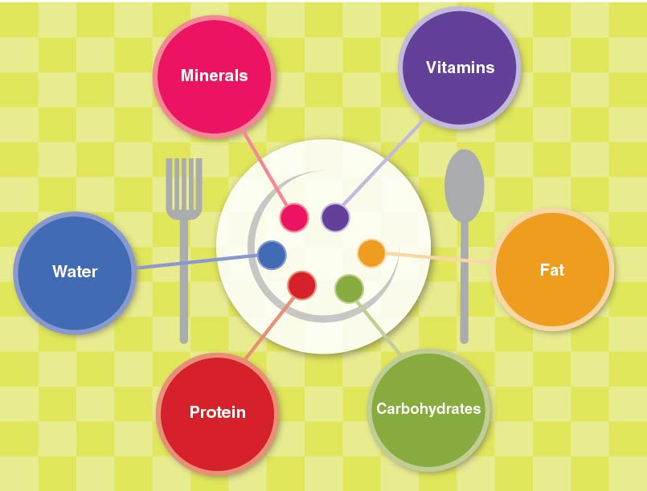
Six Categories of Nutrients
Notes:
Figure 4.1 The six categories of nutrients you need to be healthy.

Slide 6
Energy Nutrients and Foods
Calories are the form of energy found in foods.
Eating enough calories from the right types of foods is important.
The following nutrients give us calories:
  Carbohydrates
  Fats
  Proteins
Getting the right balance of these nutrients every day is important.

Slide 7
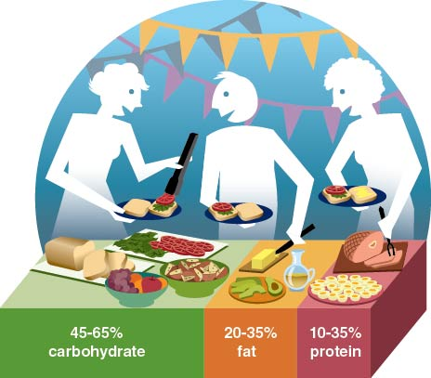
A Healthy Balance of Nutrients
Notes:
Figure 4.2 Percentage of calories recommended daily by the USDA for carbohydrate, protein, and fat.

Slide 8
Carbohydrates (1 of 2)
Carbohydrates are the main source of energy for your body.
There are two types of carbohydrates.
  Simple carbohydrates, also called simple sugars, can come from fruits and milks.
  Complex carbohydrates, also called starches, can come from bread, pasta, potatoes, and rice.
Despite their bad reputation, many carbohydrates are healthy.
(continued)

Slide 9
Carbohydrates (2 of 2)
Healthy carbohydrates contain fiber.
Fiber is found in plant foods, such as fruits, vegetables, and whole grain foods.
  Grains that have not had the fiber removed are called whole grain.
  Multigrain foods are made from two or more grains.
Fiber, which is hard for the body to digest, helps remove cholesterol from the digestive system.

Slide 10
Fats
Fats are the greasy part of foods and are another source of energy in food.
Fats are used to make hormones and serve as carriers for other substances in the blood.
Fat, stored as body fat, protects organs and keeps your body warm.
Some fats are better than others.
  Fat from plants is considered healthier than fat from animals.

Slide 11
Proteins
Proteins are substances found in food that provide calories and help build and repair tissues.
The proteins you eat are like building blocks.
  Complete proteins have all the building blocks you need. These come from animal products like eggs, meat, and cheese.
  Incomplete proteins lack one or more building blocks. Eating plant foods in combinations, like rice and beans, provides a full set of protein building blocks.

Slide 12
Vitamins and Minerals
Vitamins and minerals are small substances found in foods that are essential for life.
Vitamins and minerals have no calories, so they don’t provide energy.
These nutrients help your body create the chemical reactions needed to get the energy out of carbohydrates, fats, and proteins.
When you don’t get enough of a needed vitamin or mineral, you may experience a deficiency.
  Lack of iron, for example, can cause anemia.

Slide 13
Water
Water is essential for life. It carries nutrients around in the body and keeps the body at a constant temperature.
Your body is made up mostly of water.
Water should be the main fluid in your diet.
  Drinks such as coffee, sport drinks, and energy drinks can have unnecessary or even dangerous levels of sugar and caffeine.

Slide 14
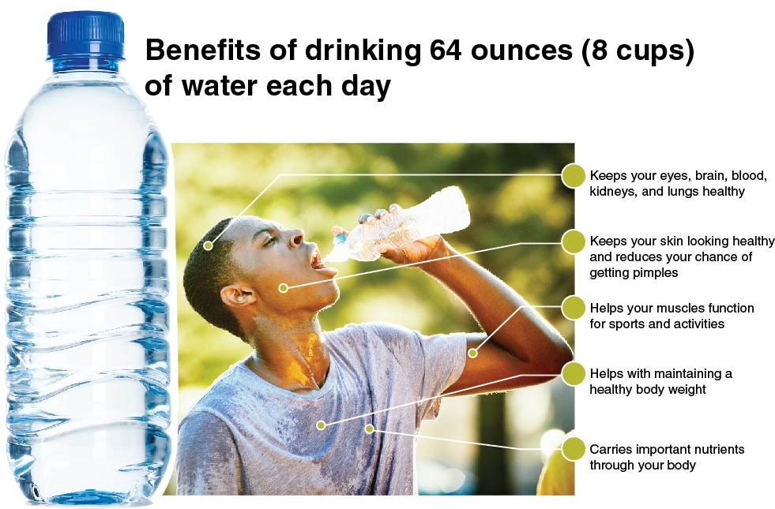
Benefits of Drinking Water
Notes:
Figure 4.7 There are many benefits to drinking water.

Slide 15
Drinks High in Sugar
Drinks high in sugar, sodium, or caffeine are not healthy choices for getting the water you need.
  Sodas can be the biggest source of sugar in your diet.
  Sugar can lead to cavities in your teeth, a risk of type 2 diabetes, and weight gain.
Drinks high in sugar are described as empty-calorie foods because they have no real nutritious value.
They also keep you from eating healthier foods.

Slide 16
Skill-Building Challenge
A public service announcement, or PSA, tries to convince the listener to agree with a point of view or change a behavior.
A clear PSA has four steps:
  Identify the issue.
  Hook your audience.
  Know your facts.
  Be straightforward.
Create a 20 to 30 second PSA about the importance of making healthy beverage choices.

