Slide 1
Energy Balance, Hunger, and Appetite
Live Well: Foundations of High School Health
Chapter 4, Lesson 2

Slide 2
Write About It
What does it feel like to be hungry?
Have you ever eaten something even though you weren’t hungry?
What influenced you to eat when you weren’t hungry?

Slide 3
Can you . . .
Explain the concept of energy balance?
Explain how energy balance relates to health?
Identify how many calories are recommended each day for males and females aged 14 to 18?
Compare hunger and appetite and explain what makes them different?
Identify and explain the major influences on appetite?

Slide 4
Energy Balance (1 of 2)
Energy balance is the relationship between the calories (energy) you eat and the calories (energy) you burn off.
The human body works best when the amount we eat is similar to the amount we use.
(continued)

Slide 5
Energy Balance (2 of 2)
Positive energy balance: If you eat more than you use, you have too many calories in your body.
  This can lead to weight gain.
Negative energy balance: When you burn off more than you eat, your body does not have enough energy.
  This can lead to weight loss.

Slide 6
How You Burn Calories
You burn energy doing three main things.
  Daily survival
    Your body burns calories daily by having your brain, heart, blood, and lungs work properly.
    The number of calories you burn to keep your basic body functions working is called metabolic rate.
  Ingesting and digesting foods
  Physical activity and movement

Slide 7
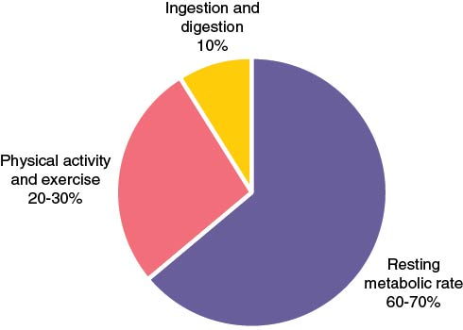
Contributors to Daily Energy Expenditure
Notes:
Figure 4.10 Contributors to daily energy expenditure.

Slide 8
Daily Energy Need (1 of 2)
Daily energy need is the number of calories you need each day to stay healthy.
Not everyone needs the same number of calories each day.
Some people need more calories because they are taller or bigger or have more muscle.
  People who are active or growing also need more energy.
  (continued)

Slide 9
Daily Energy Need (2 of 2)
Eating more calories than you need each day can lead to weight gain.
If you don’t eat enough calories each day, you may lose weight, or you may not grow and gain weight the way you should.
Not eating enough food can lead to a deficiency in which you don’t get enough of a needed nutrient.
  Deficiencies can lead to brittle hair and nails, weak bones, and poor night vision.

Slide 10
Determining Your Caloric Need
Look at the excerpt from table 4.3 (next slide) to determine a starting point for how many calories you should be consuming for your age and gender.
Determine how active you are and adjust the calories up or down slightly if needed.

Slide 11
Energy Needs Across the Life Span
The following excerpt from table 4.3 shows calories per day from sedentary to active for children ages 14 to 18.
Females | Males
1,800–2,400 | 2,000–3,200

Slide 12
Understanding Your Hunger
When your energy levels are low, your brain tells your body that it’s time to eat.
  Your stomach might be growling, or you feel like you don’t have very much energy.
This communication inside your body is hunger.
Hormones, what you eat, your physical activity levels, and even genetics influence hunger.
When your body is full and your hunger is satisfied, you are satiated.

Slide 13
Understanding Your Appetite
Appetite is all the external influences on your food choices.
Your appetite is what makes you want to eat even if you are not feeling hungry. It can also keep you from eating even when your body is hungry.

Slide 14
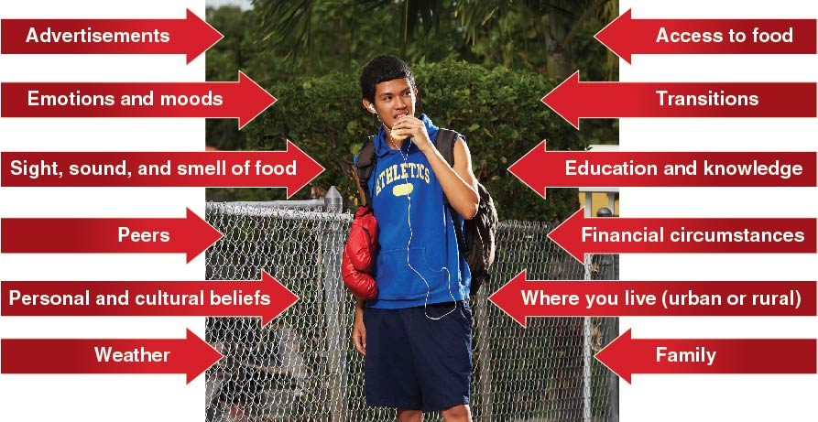
Factors That
Influence Appetite
Notes:
Figure 4.13 Factors that influence appetite.

Slide 15
Skill-Building Challenge
Think about who and what influences your food choices. Identify four influences and explain how they change your food choices.
Influence _____
This influence
  helps me eat healthier or
  does not help me eat healthier.
Explain how this influence affects you.

