Slide 1
Eating Well Across the Lifespan
Live Well: Foundations of High School Health
Chapter 5, Lesson 1

Slide 2
Write About It
In what ways have your eating habits changed since you were a young child?
Do you ever think about how nutrition might affect the way you age?

Slide 3
Can you . . .
Compare and contrast the nutritional needs of infants and children?
Identify strategies that encourage children to eat healthy?
Explain why calcium is important during the teen years?
Use communication skills to make healthy nutrition decisions?

Slide 4
Nutrition Across the Lifespan
Nutrition needs change at different phases of life.
  They reflect the needs our body has as it grows, develops, and ages.
A growing teenager has specific nutrition needs, such as the need for more iron and calcium.
The unique nutrition needs for different age groups and life circumstances are found in table 5.1.

Slide 5
Nutrition and the Teenage Years
Teenagers begin to make food and nutrition decisions during middle school and high school.
Most adolescents drink too many high-calorie drinks, snack too much between meals, and don’t consume enough fruits and vegetables.
What you eat now can influence your longevity, or the length of your life.

Slide 6
Minerals for Healthy Development
As a teenager, your body is growing rapidly.
Iron and calcium are two minerals that are very important to your body’s development.
  Iron helps your blood carry oxygen in your body.
  Calcium helps your bones grow strong and your muscles contract.

Slide 7
Iron and Teen Health
Eating a diet that’s high in iron will help your blood carry iron to your cells, which helps your body grow and develop.
Having enough iron gives you more energy throughout the day.
Not having enough iron can lead to anemia, a disease caused by low red blood cells.

Slide 8
Great Sources of Iron
Beef or chicken liver
Shellfish
Lentils and white beans
Spinach, Swiss chard, and beet greens
Dark chocolate
Sesame seeds
Green olives

Slide 9
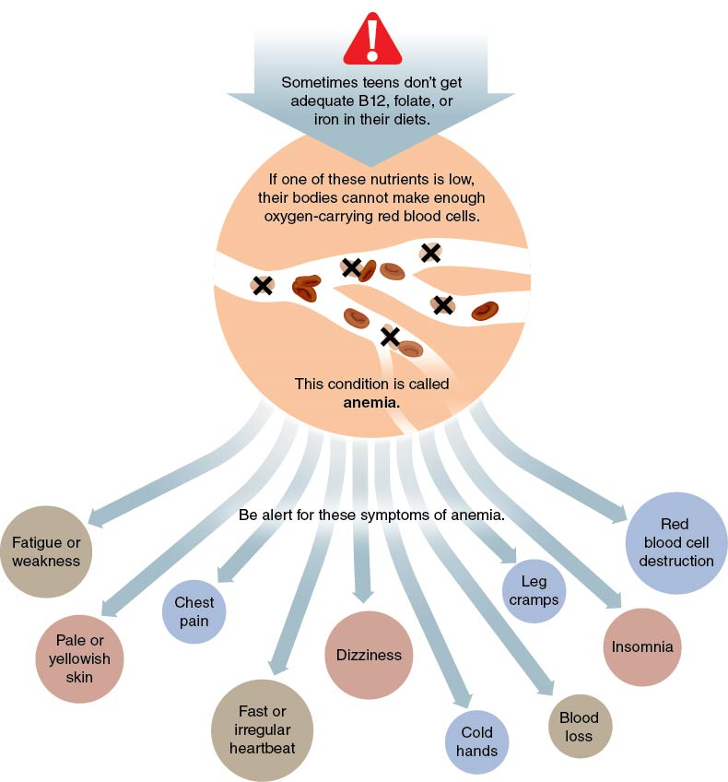
Symptoms of Anemia
Notes:
Figure 5.2 Symptoms of anemia.

Slide 10
Calcium, Vitamin D, and Teen Health (1 of 2)
Getting enough calcium and vitamin D during adolescence is essential to healthy bone growth.
Calcium helps bones grow and muscles function.
Vitamin D regulates the calcium in your blood.
Adults slowly begin to lose bone mass after age 30. You must pay attention to building strong bones before then.
(continued)

Slide 11
Calcium, Vitamin D, and Teen Health (2 of 2)
Many teens do not get the recommended amount of calcium in their diet.
  Smoking or drinking caffeinated beverages, such as soda or coffee, reduces the amount of calcium the body can absorb.
Teens, especially females, who don’t get enough calcium are at risk of developing osteoporosis (weak bones).
  Osteoporosis increases the risk of bone fractures.
  The stronger your bones are now, the more likely they will be strong in the future.

Slide 12
Communicating for Healthy Eating (1 of 2)
Learn to communicate your wants and needs so that you can make healthy choices.
Sometimes you need to say no to someone who wants you to make an unhealthy eating choice.
Other times, you may need to ask for assistance in making a smart decision.
  (continued)

Slide 13
Communicating for Healthy Eating (2 of 2)
Learn to say no in an unhurtful way to help yourself eat well.
Ask for help if you feel confused by the food options you have.
Negotiate with others to make healthier food choices.

Slide 14
Skill-Building Challenge
Read the scenario and choose a communication strategy to use in the situation.
Scenario A: Phoenix bought Jessep a cupcake for her birthday, but Jessep is trying to cut back on sweets and doesn’t want to eat the cupcake.
Scenario B: Marcus is trying to get more nutrients in his diet, but he doesn’t know what to pick for his lunch. The food truck he is at has a lot of options, but some are foods he doesn’t recognize.
  What communication strategy could Jessep or Marcus use to make the best choices for their diets?
  What are the potential outcomes of using these strategies?

