Slide 1
Maintaining a Healthy Weight
Live Well: Foundations of High School Health
Chapter 5, Lesson 3

Slide 2
Write About It
Identify five influences on your weight.
List them in order from most significant to least significant influence.
Do you think others experience these same influences in the same way? Explain your response.

Slide 3
Can you . . .
Explain influences on body weight?
Describe what a healthy weight is?
Explain healthy ways to lose and gain weight?
Explain the risks of fad diets and supplements, including anabolic steroids?
Access valid and reliable information about weight-loss supplements?

Slide 4
Why Is Weight Important?
Obesity is linked to increased risk for a variety of diseases, including type 2 diabetes, coronary heart disease, and some cancers.
Weight can be influenced by genetics, the environment, and behaviors.
However, weight is not the whole story. People who are physically active are generally healthier than those who aren’t, regardless of weight.

Slide 5
What Is Body Composition?
Body composition refers to the ratio of lean (muscle) tissue to fat tissue in your body.
A person with more lean tissue and less fat tissue is generally at lower risk for most diseases.
This is true even if the person’s weight is higher than average.
Fat distribution also plays a role.
  Abdominal fat, or fat around the waist, is the most dangerous kind to have.

Slide 6
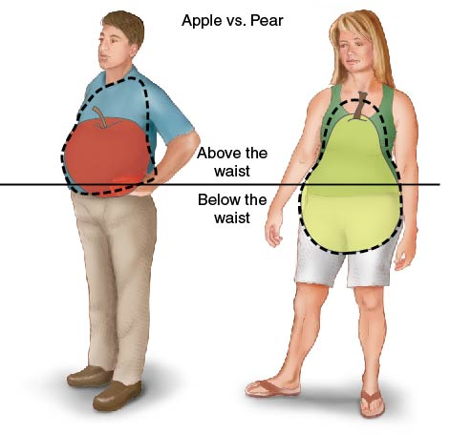
Body Fat Distribution
Notes:
Figure 5.7 Fat in the upper body is called an apple-shaped distribution; fat in the lower body is called a pear-shaped distribution.

Slide 7
Measuring Body Composition and Fat Distribution
Technique | Description
Skinfold calipers | Fat just below the skin is pinched and measured.
Bioelectrical impedance (BIA) | A small current is sent through the body, and the amount of water and lean tissue is estimated from the speed of the current. Handheld devices, body composition scales, and traditional electrode versions exist.
Underwater weighing | A person is weighed while under water. The volume of the body and the underwater weight of the body are used to estimate the amount of fat tissue in the body.
Waist-to-hip ratio | The waist is measured at the narrowest point and the hips are measured at the widest point. The waist measure is divided by the hip measure. A number under 0.80 for females and 0.95 for males is considered healthy.

Slide 8
What Is a Healthy
Weight for Me?
Human beings come in all shapes and sizes, and we are all genetically different.
Being underweight or overweight does not automatically mean you have a disease or have done something wrong.
A healthy weight is a weight that you are comfortable with and that you can maintain by following basic nutrition and physical activity guidelines.

Slide 9
Losing and Gaining Weight
There are safe ways and unsafe ways to lose or gain weight.
As a teenager, you should consult with your parents and physician before making any decisions about losing or gaining weight.
Since teenage years are a critical time for your body’s growth and maturation, make sure you don’t do anything that might cause long-term health challenges.

Slide 10
Gaining Muscle Mass
(1 of 2)
Typically, when someone is trying to gain weight, they are trying to gain more muscle mass.
When trying to gain healthy weight, focus on eating more nutrient-dense food and doing more resistance training.
  Eating foods high in sugar or fat does not help because it typically increases body fat.
  Eating foods high in protein is not effective either because excess protein is not turned into fat very easily.
  (continued)

Slide 11
Gaining Muscle Mass
(2 of 2)
Using supplements or steroids for weight gain is not a healthy approach.
Anabolic steroids are a class of hormones that can stimulate muscle growth but can also cause the following:
  Damage to the cardiovascular system, liver, and kidneys
  Severe acne
  Hair loss
  Mood swings

Slide 12
Healthy Weight Loss
There is no easy way to lose weight.
A healthy rate of weight loss is between one and two pounds per week.
  A person must decrease calories or increase physical activity by 500 to 1,000 extra calories a day.
  Most people would need to do 60 to 90 minutes of extra physical activity every day to burn 500 extra calories.
A combination of eating the right amount of nutrient-dense foods and increasing physical activity is the healthiest way to lose body fat and weight.

Slide 13
Dangerous Dieting Habits
People often turn to fad diets and diet pills to lose weight.
People who lose weight quickly on these diets and products often gain the weight back quickly as well, which is called weight cycling.
From a health perspective, it is often better to carry a few extra pounds than to repeatedly gain and lose weight.

Slide 14
Skill-Building Challenge
Use the Internet to research a weight loss supplement or fad diet trend.
Find at least three websites that provide the following information on the product:
  What is the name of supplement or diet?
  How does it help with weight loss?
  Is the information logical and does it make sense?
  Is the information consistent across sites?
  Is the product safe? What are its risks?

