Slide 1
Being Physically Active and Physically Fit
Live Well: Foundations of High School Health
Chapter 6, Lesson 1

Slide 2
Write About It
Physical activity, exercise, and physical fitness are three terms you may have heard when thinking about being active.
List concepts you think are similar about the three terms and concepts you think are different about them.

Slide 3
Can you . . .
Compare and contrast physical activity, exercise, and physical fitness?
Evaluate the physical, mental, and social benefits of physical activity on your health?
Predict how physical activity can affect your health status?
Identify three activities you could do at home when taking an activity break?
Design a schedule you could use daily to get your 60 minutes of exercise completed?
Analyze the influence of your personal values on inactivity in your life?

Slide 4
Understanding Physical Activity, Exercise, and Physical Fitness
Physical activity is movement using the large muscles of the body, such as sports, dance, swimming, and biking.
Exercise is planned, structured, and repetitive physical activity for improving or maintaining one or more components of fitness.
Physical fitness refers to your body systems being able to work together efficiently for health and daily activities.

Slide 5
Physical Activity Benefits
Participating in physical activity produces physical, mental, and social benefits.
  Physical benefits: building healthy bones and muscles, decreasing the likelihood of obesity, increasing energy, improving sleep
  Mental health benefits: helping to reduce anxiety and depression, increasing concentration
  Social benefits: meeting new people, developing new friendships, learning to work with others

Slide 6
Physical Activity and Disease Prevention
Being physically active on a regular basis helps reduce your risk of chronic diseases such as type 2 diabetes, heart disease, cancer, high blood pressure, and dementia.
Currently, about one in two adults have at least one chronic disease.
Only half of the adults in the United States get the physical activity needed to prevent chronic diseases.

Slide 7
Physical Activity Guidelines for Teens (1 of 2)
The U.S. Department of Health and Human Services recommends that teens get 60 minutes or more of moderate-to-vigorous physical activity daily.
  Moderate intensity is equal to a brisk walk.
  Vigorous intensity is equal to a continuous jog.
Your physical activity should mostly be aerobic.
  Aerobic means with oxygen and occurs over longer periods of time. It makes your heart beat faster and your breathing harder than normal.
  (continued)

Slide 8
Physical Activity Guidelines for Teens (2 of 2)
You can divide your 60 minutes of activity into smaller amounts of time.
  Consider four 15-minute physical activity breaks or three 20-minute breaks.
There are many ways to be physically active.
  Take the stairs instead of the elevator.
  Set an alarm when doing your homework and take a 10-minute break every hour for physical activity.
  Have contests to see who can do the longest wall sit or the longest plank.

Slide 9
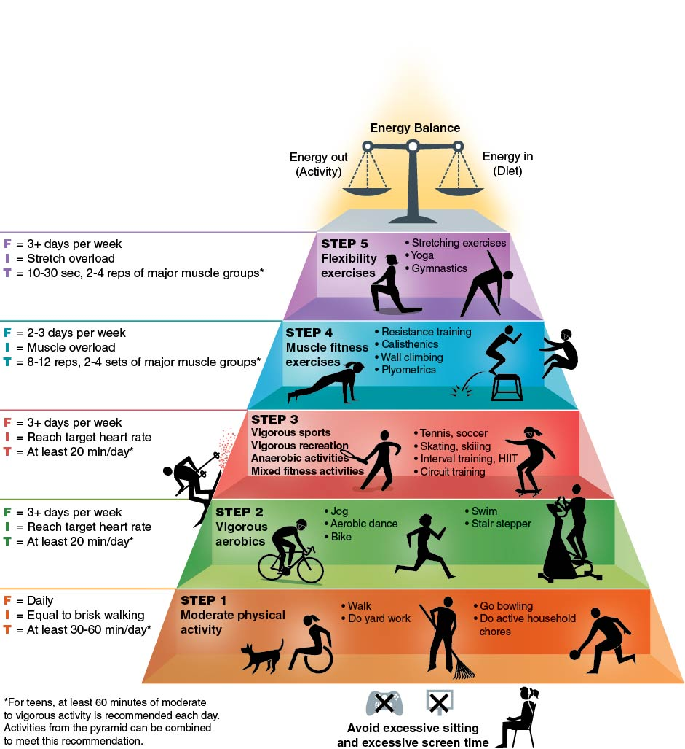
The Physical
Activity Pyramid
Notes:
Figure 6.2 The Physical Activity Pyramid shows you how to include different types of physical activity in your life.
© C.B. Corbin

Slide 10
Physical Activity and Daily Routine
Think about how you can incorporate physical activity into your daily routine.
Since being physically active gives you more energy and makes you feel better, find activities you enjoy.
Being physically active should be something you want to do, not have to do.

Slide 11
How to Overcome Inactivity
Think about how to avoid excuses for inactivity.
  I don’t have the time. Plan time throughout the day.
  None of my friends exercise. Find activities you can do with your friends.
  I'm not good at sports. Pursue non-sports activities such as walking, bike riding, swimming, or dancing.
  I’m too tired. Begin slowly and increase the amount of activity.
  People will make fun of me. Find activities that you enjoy. Remember that your workout is for you, not anyone else.

Slide 12
Skill-Building Challenge
Work with a partner to advocate for brain boosts or activity breaks during the school day.
Create a letter for your school administrators, using the following questions.
  What do you want to see changed in your school?
  What information will best get your message across?
  Who is your audience?
  What is your message?
  If you have the chance to share your letter, did your message work?

