Slide 1
Your Emotional Health
Live Well: Foundations of High School Health
Chapter 7, Lesson 1

Slide 2
Write About It
When is the last time you felt empathy from someone else?
Describe the situation and explain how their response impacted how you felt in the situation.

Slide 3
Can you . . .
Explain how emotional health relates to overall health and wellness?
Describe influences on emotional health?
Explain each of the four parts of emotional intelligence?
Explain why empathy is important to relationships?
Describe the risks of not having good impulse control?

Slide 4
Emotional Health
Having good emotional health means that you have a positive state of well-being that allows you to function in society and meet the demands of your daily life.
Mental health involves successful thinking and mental processing.
Mental health exists on a full range from optimal functioning to serious mental illness.

Slide 5
What Are Emotions?
Emotions are physiological—meaning that they are electrochemical signals that flow through the body in an unending cycle.
Emotions help us focus our attention and motivate our behavior.
Emotions are neither positive nor negative. How we choose to respond to emotions affects our emotional health.

Slide 6
What Makes Me Emotionally Healthy?
People with good emotional health share several strong, positive characteristics.
Emotional intelligence refers to your ability to perceive, manage, and regulate your emotions.
Emotional intelligence includes the following:
  Self-awareness
  Self-management
  Social awareness
  Social skills

Slide 7
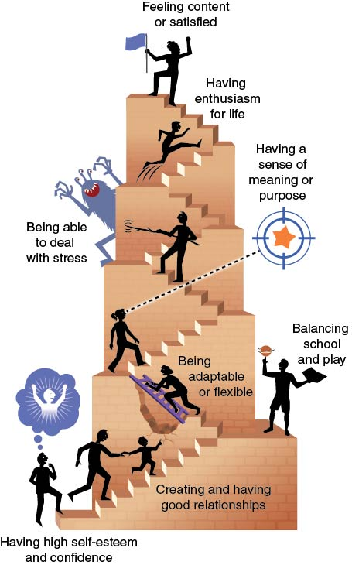
Characteristics of Positive Emotional Health
Notes:
Figure 7.1 Characteristics of positive emotional health.

Slide 8
Communicating Your Emotions
People are social beings, and emotions drive much of our connection with others.
When we are struggling with our emotions, it can help us to talk to other people.
Our positive and negative responses to emotions should be shared with others.

Slide 9
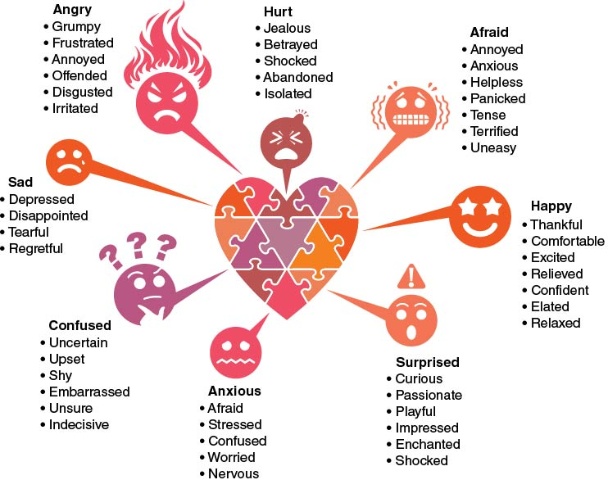
Communicating Emotions Effectively
Notes:
Figure 7.3 Building a varied and robust emotional vocabulary can help us communicate emotions more effectively.

Slide 10
Developing Empathy
Empathy is your awareness of other people’s feelings and emotions.
If you unable to relate to others’ emotions, it’s challenging to develop meaningful relationships or function in society.
Sometimes we aren’t good at showing empathy.
  Sometimes we don’t value others who are different from us because we assume they don’t feel or behave like we do.

Slide 11
Ways We Develop Empathy
Sharing in other people’s life stories
Trying to understand differences in social cultures, values, and traditions
Asking questions and learning about situations different from our own

Slide 12
Managing Impulses
Being impulsive is one consequence of not being able to manage emotions well.
Impulsiveness is when you act suddenly while ignoring the consequences of the decision or behavior.
Studies have linked impulsiveness to higher risks of smoking, drinking, drug abuse, compulsive gambling, aggressive behavior, and eating disorders.

Slide 13
Skill-Building Challenge
Read the scenarios in the chart.
For each scenario, identify a strategy that the person could use to help control their emotions and then explain how that strategy might affect the outcome.
Describe a situation in which you did not use good emotional control. Identify a strategy you could use if faced with a similar situation in the future.

