Slide 1
Developing Emotional Health and Mental Toughness
Live Well: Foundations of High School Health
Chapter 7, Lesson 3

Slide 2
Write About It
Describe someone in your life who can keep going even when things aren’t going the way they want them to.
What do you think gives them this type of strength or ability?

Slide 3
Can you . . .
Explain the concept of mental toughness?
Compare and contrast resilience and grit?
Contrast a growth mindset with a fixed mindset?
Provide three examples of negative self-talk?

Slide 4
Mental Toughness
Mental toughness is the ability to overcome doubts, worries, and circumstances that prevent you from succeeding.
People who are mentally tough tend to
  view challenges as opportunities, not obstacles,
  believe they are in control of their life and destiny,
  have the ability to stick to tasks and see them through to completion, and
  possess strong self-belief in their ability to succeed.

Slide 5
Optimism and Emotional Health
A person who has a generally positive outlook and positive behaviors is said to be optimistic.
  It doesn’t mean being happy all the time, but rather looking for the positive in situations.
Optimistic people typically have better emotional health.
In contrast, being pessimistic, or seeing the worst aspect of things and expecting the worst, can increase your health risks and shorten your life span.

Slide 6
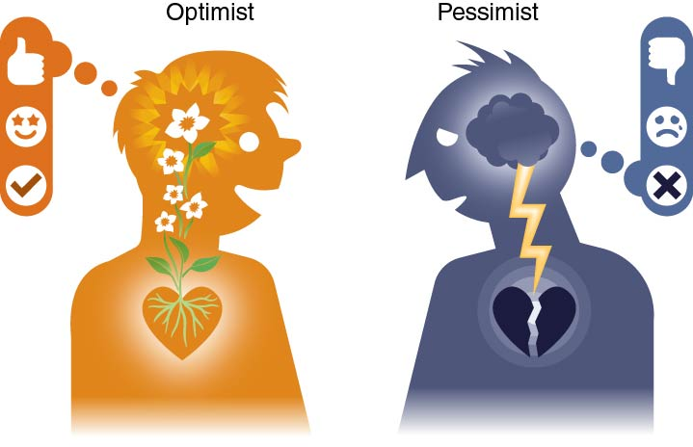
Optimism Versus Pessimism
Notes:
Figure 7.9 Optimism versus pessimism.

Slide 7
Growth Mindset
A growth mindset means that you believe you can develop your talent and skills and you can learn and grow through any situation.
If you give up because you assume you can’t learn math, you have a fixed mindset.
  A fixed mindset causes you to give up or lose confidence.
Students who have a growth mindset do better in school and develop more resilience.

Slide 8
Becoming Resilient
Being mentally tough requires resilience.
Resilience is your ability to bounce back from a difficult or stressful situation.
Resilience is not a trait, or something you are born with. It is a skill that you can develop and improve with effort.

Slide 9
Skills for Becoming More Resilient
Develop your competence.
Believe in yourself.
Create connections with people who offer support and present challenges.
Learn to cope with stressful circumstances.
Take control of your actions.
Be courageous.
Stick with your goals, despite challenges.

Slide 10
Skills for Developing Grit
Be courageous.
Be conscientious.
Stick with it.
Seek mastery.

Slide 11
Self-Talk for Mental Toughness
Self-talk is the messages we send to ourselves; it is our inner conversation with our self.
The type of self-talk you use will have an impact on your emotional wellness and mental toughness.
Self-talk can be negative or positive.
  By learning to recognize negative self-talk, we can challenge and change these messages and the feelings they create.

Slide 12
Ways We Engage in Negative Self-Talk
Pattern | Description | Example
Jumping to conclusions | Failing to think things through and jumping to a quick, negative conclusion | My friend didn’t text me, so she must hate me.
Making things your own fault | Making everything about you or your fault (personalizing) | My friend did poorly on his exam because I wasn’t able to study with him the night before the test.
Making things worse | Making something far more significant or dramatic than it is (catastrophizing) | I got a B on my quiz. I’m totally going to fail now.
Making things smaller | Making accomplishments smaller than they really are | Even though I got an A on the test, I missed the easiest question. I’m so dumb!
Making things bigger | Applying something specific to a bigger thing | I forgot my permission slip. I can’t remember anything.
Giving it a name | Calling yourself names (labeling) | I’m so fat and stupid.

Slide 13
Skill-Building Challenge
Set short- and long-term goals to help you build the skills you need to be mentally tough.
Remember to make your goals SMART goals.
Revisit your goals to evaluate your progress and reflect on what helped or hurt you in achieving your goals.

