Slide 1
Understanding and Treating
Mental Disorders
Live Well: Foundations of High School Health
Chapter 8, Lesson 1

Slide 2
Write About It
What do you know about mental disorders?
What things do you think influence a person’s risk of developing a mental disorder?

Slide 3
Can you . . .
Explain what a mental disorder is and provide two examples?
Describe what stigma is and explain how it can affect someone with a mental disorder?
Explain different ways that mental disorders may be treated?

Slide 4
What Are
Mental Disorders?
A mental disorder is a serious and ongoing problem involving how a person thinks and manages emotions.
A wide range of mental disorders can be diagnosed by a mental health professional.

Slide 5
Examples of Mental Disorders
Anxiety disorders
Attention deficit hyperactivity disorder
Obsessive compulsive disorder
Post-traumatic stress disorder
Mood disorders
Personality disorders
Schizophrenia

Slide 6
Mental Disorders and Youth by the Numbers
More than 1 in 3 high school students had experienced persistent feelings of sadness or hopelessness in 2019, a 40 percent increase since 2009.
In 2019, approximately 1 in 6 youth reported making a suicide plan in the past year, a 44 percent increase since 2009.
During the COVID-19 pandemic in 2021, 37 percent of high school students reported they experienced poor mental health, and 44 percent reported they persistently felt sad or hopeless.
Cases of anxiety, depression, and self-harm among U.S. teens aged 13 to 18 all increased between 2019 and 2022.

Slide 7
Causes of Mental Disorders
A variety of factors come together to affect an individual’s likelihood of developing a mental disorder.
  Genetics and family history
  Environment and experiences
  Brain injury
  Prenatal history
  How the brain functions

Slide 8
Care and Treatment of Mental Disorders
Many treatment options are available for mental disorders.
The exact treatment or combination of treatments depends on the disorder and the person.
Common treatment options include psychotherapy, counseling, medication, and substance abuse counseling.
Hospitalization may be used in more severe situations.

Slide 9
Counseling and Psychotherapy
Psychotherapy and counseling are methods of treating mental disorders that involve talking about the condition and related issues with a mental health care provider.
The person uses insight and knowledge gained from the treatment to learn coping and stress management skills.
Psychotherapy can sometimes be successfully completed in a few months, but in some cases long-term treatment is helpful.

Slide 10
Medication
Medication does not cure a mental disorder, but it can provide significant relief from symptoms:
  Antidepressant medications
  Mood-stabilizing medications
  Anti-anxiety medications
  Antipsychotic medications

Slide 11
Social Stigma and Mental Disorders
A stigma is a distinguishing characteristic or personal trait that is thought to be, or actually is, a disadvantage.
Many people see mental disorders as a stigma, which can lead to prejudice on individuals with disorders.
Learning about mental disorders and developing empathy for the challenges they cause will help to reduce prejudice toward those with mental disorders.

Slide 12
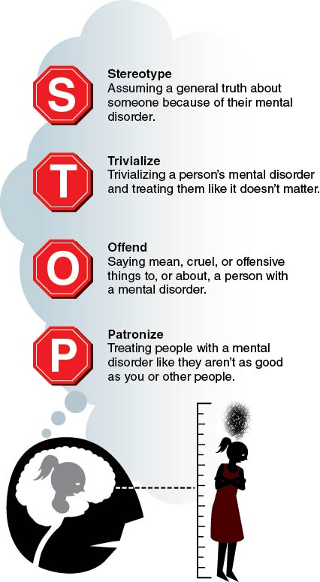
Use STOP to Recognize Stigma
Notes:
Figure 8.2 Use STOP to help you recognize stigma and avoid applying it.

Slide 13
Skill-Building Challenge
Read each scenario. Each situation includes an inappropriate response from a friend.
Discuss with a partner or small group the appropriate responses the friend could use.
Decide which response you think works best for the situation and practice it with your partner or group.

