Slide 1
Anxiety and Anxiety Disorders
Live Well: Foundations of High School Health
Chapter 8, Lesson 2

Slide 2
Write About It
What does it feel like to be anxious?
Identify a time when you were feeling anxiety and try to describe what it felt like and what you noticed about how you felt.

Slide 3
Can you . . .
Compare and contrast anxiety and anxiety disorders?
Identify five symptoms of anxiety disorder?
Explain three common influences on teen anxiety?
Describe the value of gratitude and explain two ways to practice it?

Slide 4
Anxiety Disorders
Anxiety is an emotion that includes tension, worried thoughts, and physical change like increased blood pressure.
People with anxiety disorders frequently have intense, excessive, and persistent worry and fear about everyday situations.
These feelings of anxiety and panic interfere with daily activities like going to school or hanging out with friends.

Slide 5
Common Anxiety Disorders
General anxiety disorder
Panic attacks or panic disorder
Social anxiety disorder
Simple phobia
Separation anxiety
Selective mutism

Slide 6
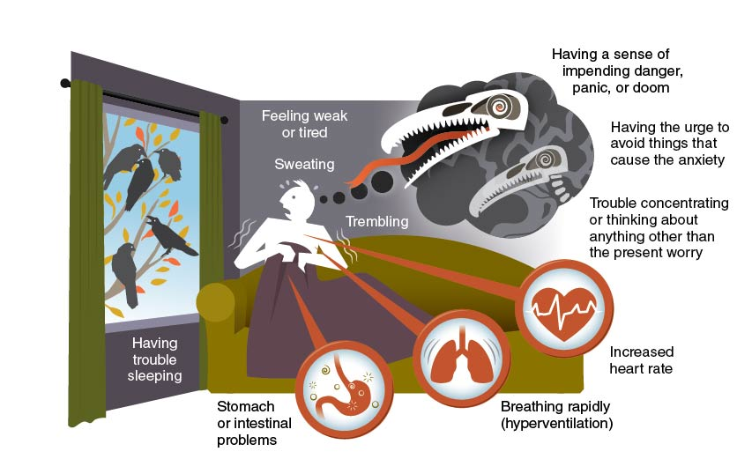
Common Symptoms of Anxiety Disorders
Notes:
Figure 8.3 Common symptoms of anxiety disorders.

Slide 7
Influences on Anxiety Disorders in Teens
Several social influences have contributed to the rise of anxiety-related disorders in teens.
High expectations and the pressure to succeed
Social threat and violence
Social media and its potential judgment and criticism

Slide 8
Getting Help for Anxiety Disorders
Mental disorders, such as anxiety, can be hard to manage.
Common techniques for managing anxiety-related disorders include
therapy,
medication,
support groups, and
self-care.

Slide 9
Practicing Gratitude
Gratitude refers to being appreciative for the large and small things you have and experience in life.
Strategies for practicing gratitude include
daily three,
counting your blessings,
gratitude alphabet, and
journal.

Slide 10
Skill-Building Challenge
Look over the strategies in the Practicing Gratitude section and think about other ways you can practice gratitude.
Identify two options that might work for you.
Try out each strategy for at least one week. Then reflect on how well they worked.

