Slide 1
Relationships and Communication Skills
Live Well: Foundations of High School Health
Chapter 9, Lesson 1

Slide 2
Write About It
Describe a text message, social media post, or conversation that was taken in a way that was very different from how you intended.

Slide 3
Can you . . .
Evaluate similarities and differences between verbal and nonverbal communication?
Compare and contrast characteristics of healthy and unhealthy relationships?
Experiment with your communication style using the four communication styles described?
Demonstrate how to use an I message and active listening properly?
Analyze how a text message or a social media message could be interpreted in two different ways?

Slide 4
Relationships
Relationships are connections between people.
You have different relationships with different people in your life.
  Family members
  Friends
  Teachers
  People you date

Slide 5
Healthy Relationships
A healthy relationship allows both people to feel supported and connected without losing their individuality.
Social health is your ability to interact and form meaningful relationships with others.
People like to be around other people who make them happy, who make them laugh, and with whom they can have fun.
Healthy relationships helps reduces your stress and have a healthier immune system.

Slide 6
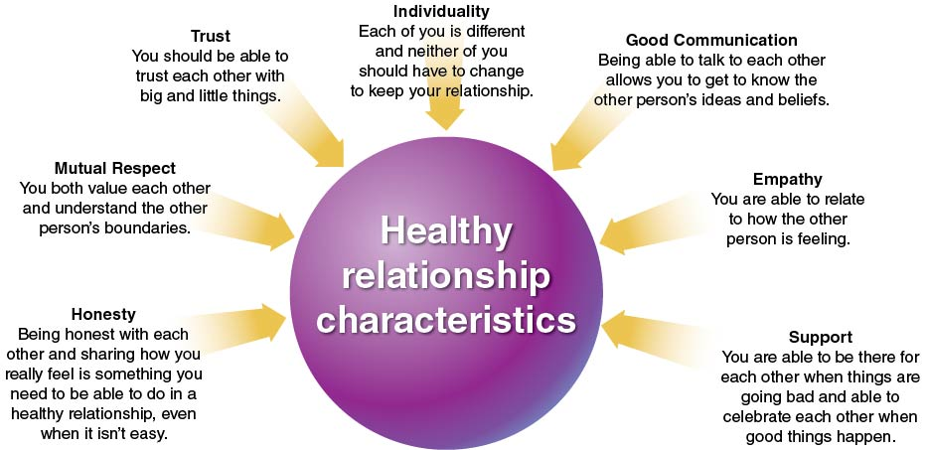
Healthy Relationship Characteristics
Notes:
Figure 9.1 Healthy relationship characteristics.

Slide 7
Unhealthy Relationships
An unhealthy relationship is one that can leave you feeling uncomfortable, sad, or afraid.
In an unhealthy relationship, people often have many arguments without working things out and coming to an agreement.

Slide 8
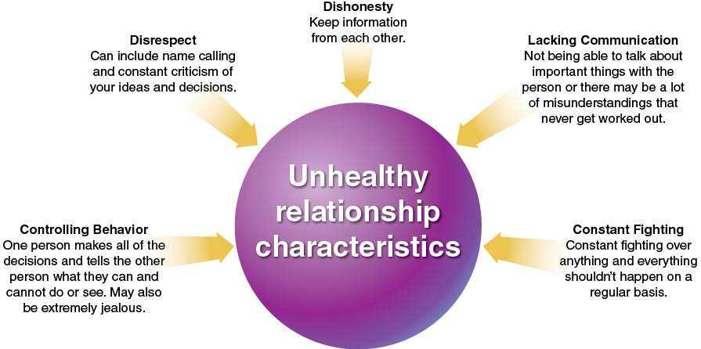
Unhealthy Relationship Characteristics
Notes:
Figure 9.2 Unhealthy relationship characteristics.

Slide 9
Communication
Is a Two-Way Street
Communication is the exchange of information between two or more people.
Effective communication is a two-way street: You must be able to both talk and listen.

Slide 10
Verbal and Nonverbal Communication
Verbal communication uses spoken and written words to express information you are sharing.
Nonverbal communication uses body language, including facial expressions, hand gestures, and tone of voice.

Slide 11
Active Listening
Active listening means giving your full attention to the speaker and actively showing verbal and nonverbal signs that you are listening.
  Verbal signs include asking questions or paraphrasing what you have heard.
  Nonverbal signs include making eye contact, nodding your head, and smiling.

Slide 12
I Messages
I messages are used to express how you are feeling and what you need.
An I message has four parts:
  “I feel . . .” (take responsibility for your own feelings)
  “When you . . .” (stating the behavior that is a problem)
  “Because . . .” (what it is about the behavior or its consequences that you don't like)
  “I would really like it if . . .” (offering a preferred alternative or a compromise)

Slide 13
Communication Styles
Passive communication: doesn’t like to express their feelings, tries to avoid confrontation
Aggressive communication: tells people what to do, doesn’t really care about others’ feelings
Passive-aggressive communication: seems passive yet will give a person the silent treatment or talk about them behind their back
Assertive communication: uses I messages and expresses their own needs, feelings, and goals

Slide 14
Communicating Through Text Messages and Social Media
Text messages and social media posts don’t always get the intended message across because they don’t have the nonverbal communication or the active listening to go with them.
Make sure your text messages and social media posts are not hurtful to anyone and are well thought out.

Slide 15
Skill-Building Challenge
Read the scenario about Isla and Kay.
Write an I message explaining how Kay feels, making sure to use the four parts of I messaging.
Write a response Isla could make to Kay’s I message, using the four parts of active listening.

