Slide 1
Friendships
Live Well: Foundations of High School Health
Chapter 9, Lesson 3

Slide 2
Write About It
High school is a time when your friends may be changing depending on the classes you are in and the activities you are involved in.
Think about what qualities you want in a friend and write those down.
Do your current friends have the qualities you want them to?

Slide 3
Can you . . .
Differentiate your friends into the four types of friends discussed in the lesson?
Explain the four qualities a close friend needs to have?
Analyze how social media, jealousy, and drama can cause problems in a friendship?
Create a plan to work on a quality you need to improve on to be a better friend?
Use healthy ways to express love in a friendship?

Slide 4
Types of Friendships
(1 of 2)
Your relationship with friends becomes very important during adolescence.
Teens become more independent from their family and make decisions on their own.
Friendships provide a type of support and help you feel like you belong and are part of something special.
An emotional connection means you trust, respect, and share anything with the friend.
(continued)

Slide 5
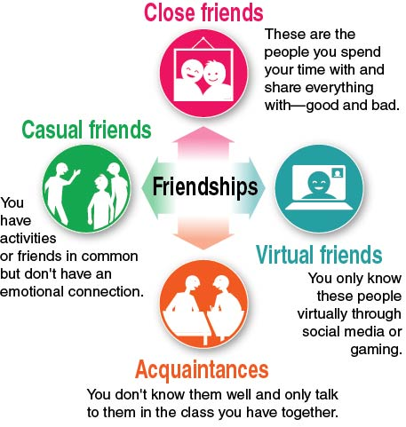
Types of Friendships
(2 of 2)
Notes:
Figure 9.4 The four types of friendships.

Slide 6
What It Takes to Be a Close Friend
Close friends make time for each other and spend time together.
Close friends are there for each other through good and bad times no matter what.
Close friends put in the effort to keep the friendship strong.

Slide 7
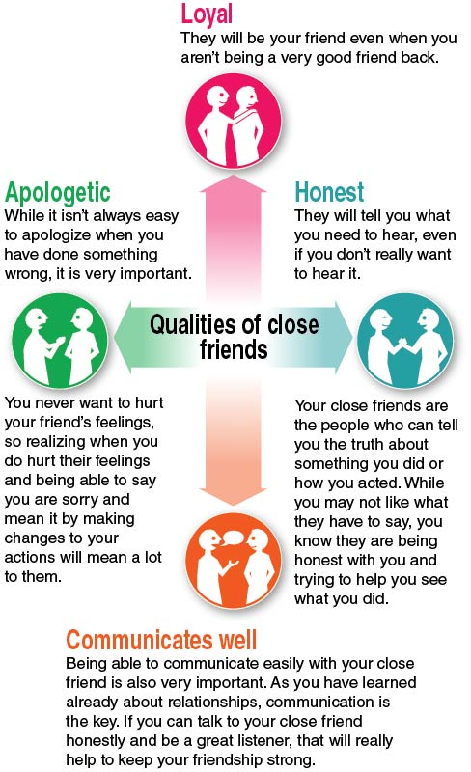
The Four Qualities of Close Friends
Notes:
Figure 9.5 The four qualities close friends should have.

Slide 8
When Friendships Have Problems
Problems in a friendship don’t mean the friendship is at risk of ending. It means you have things to work on.
Three factors can cause problems in a friendship:
  Social media
  Jealousy, or a perceived threat from a third person
  Drama, or gossiping and spreading rumors

Slide 9
Healthy Ways to Express Love in a Friendship
Love in a friendship means friends really care about each other.
Simple ways to show love to a friend include:
  being there for them when they need you,
  telling them what they mean to you,
  showing social media love by posting memories and pictures, and
  being a loyal and caring friend.

Slide 10
Skill-Building Challenge
Read the scenario about Aliya and Rahmi. What do you think Aliya should do?
Answer the following questions:
  What is the problem with this relationship?
  What are Aliya’s options?
  What are the consequences of each option Aliya has?
  What decision do you think Aliya should make?

