Slide 1
Anger, Aggression, and Conflict
Live Well: Foundations of High School Health
Chapter 10, Lesson 2

Slide 2
Write About It
When you experience a conflict, how does it make you feel?
How do you usually handle conflict?

Slide 3
Can you . . .
Compare and contrast aggression and assertiveness?
Illustrate each common cause of conflict using a realistic example?
Compare and contrast two styles of managing conflict?
Practice the steps of conflict resolution?

Slide 4
Anger and Aggression
Anger is a normal human emotion.
Aggression is when someone engages in a forceful action with the intent to dominate or control another person.
  Aggression is a behavior, not an emotion.
  Aggression is not always violent, such as in competitive sport.
  Aggression is often linked with violence.

Slide 5
Assertiveness
Assertiveness is a nonviolent and confident way of expressing your point of view.
Being assertive is often viewed as a positive thing, while aggression is viewed more negatively.

Slide 6
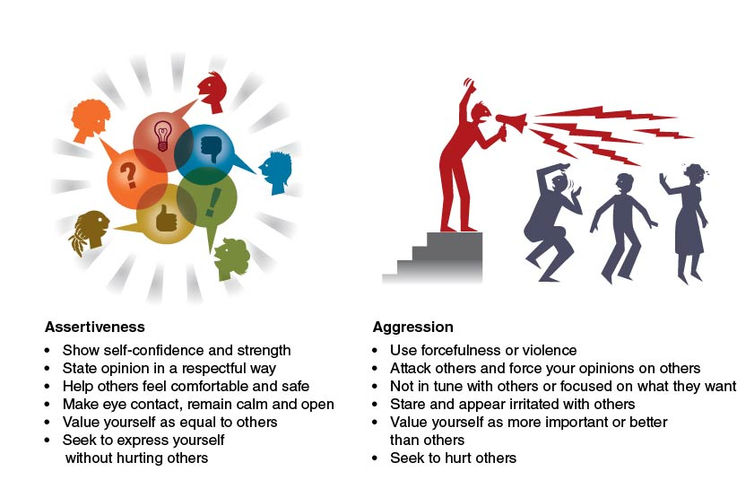
Assertiveness Versus Aggression
Notes:
Figure 10.5 Assertiveness versus aggression.

Slide 7
Understanding Conflict
Conflict occurs when two or more people disagree on an issue and feel threatened in some way.
Conflict is unavoidable and not always bad.
Conflict is often caused by different
  values,
  relationships,
  interests, and
  resources.

Slide 8
Managing Conflict
When we don’t manage conflict effectively, the situation can escalate, or become more intense.
Styles for managing conflict include the following:
  Accommodating approach
  Avoiding approach
  Collaborating approach
  Competing approach
  Compromising approach

Slide 9
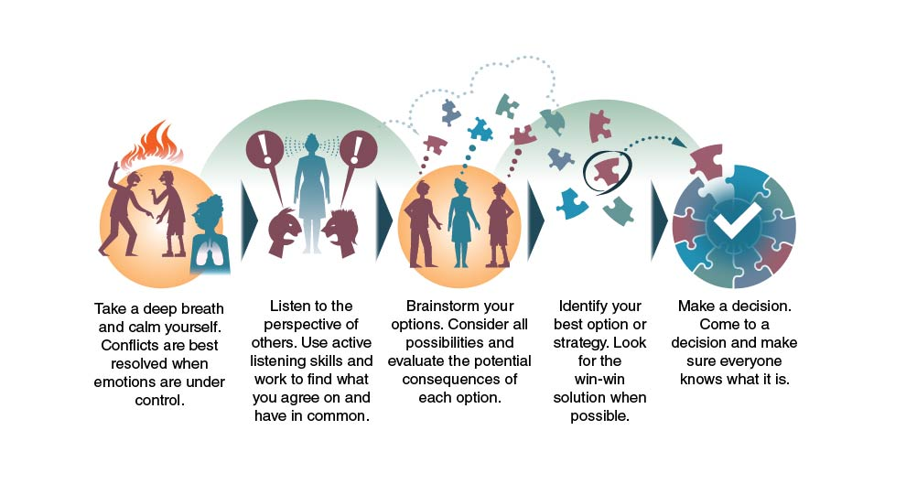
Conflict Resolution
Conflict resolution is the process for finding a peaceful solution to a disagreement.
Notes:
Figure 10.7 Steps to conflict resolution.

Slide 10
Skill-Building Challenge
Read the scenarios. Discuss which conflict management approach is illustrated in each and describe why the approach is harmful or unsuccessful.
Decide how best to resolve the conflict in order to provide a helpful and successful solution.

