Slide 1
Alcohol Use, Effects, and Consequences
Live Well: Foundations of High School Health
Chapter 11, Lesson 1

Slide 2
Write About It
What do you know about the different types of alcoholic drinks?
Do they all contain the same amount of alcohol? Is there a standard drink size?

Slide 3
Can you . . .
Describe standard drink sizes of alcoholic beverages?
Analyze specific components of the fetal alcohol spectrum disorders?
Illustrate how teen alcohol use has an impact on risk-taking behaviors?
Compare how alcohol consumption can affect school and job performance?
Examine the potential impacts drinking and driving has on a person’s life?

Slide 4
What Is Alcohol?
Alcohol is one of the most used and abused substances for high school students.
Alcohol is legal only for people 21 and older.
Alcohol is a depressant.
  Makes brain function slower than normal
  Makes basic tasks, like walking, talking, and making simple decisions, more difficult
The most common types of alcohol are beer, wine, and liquor.

Slide 5
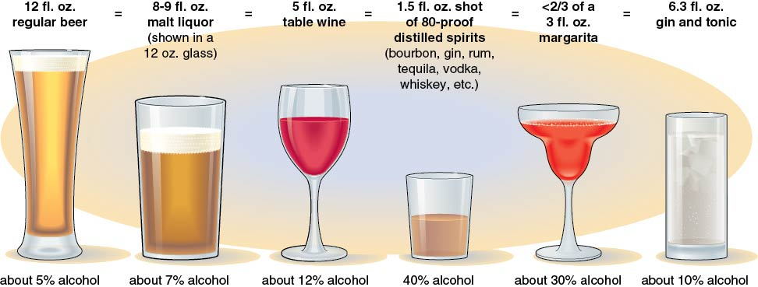
Standard Sizes of Alcoholic Drinks
Notes:
Figure 11.2 Standard sizes of alcoholic drinks.

Slide 6
Alcohol Consumption
Moderate drinking, or social drinking, means having up to one drink per day for women and up to two drinks per day for men.
Binge drinking means consuming many drinks in a short amount of time and on a regular basis.
Heavy drinking for a male is more than four drinks a day or 15 or more per week. Heavy drinking for a female is more than three drinks a day or eight or more per week.

Slide 7
Teen Alcohol Use and Risk Taking
Teens who have been drinking alcohol are more likely to take risks than those who have not.
The risks may result in falls, drownings, burns, and unintentional firearm injuries.
Drinking also causes teens to become more violent and more liable to get into fights.

Slide 8
Emotional Reasons for Alcohol Use
Increase positive mood
Gain approval
Reduce painful, negative feelings
Fit in

Slide 9
Reducing Teen Alcohol Consumption
Teens drink to increase their positive mood, to gain approval or fit in with peers, or to reduce the pain of negative feelings.
There is no easy way to prevent teens from using alcohol.
Teens should be taught that there are other ways than drinking to celebrate something or work through something.

Slide 10
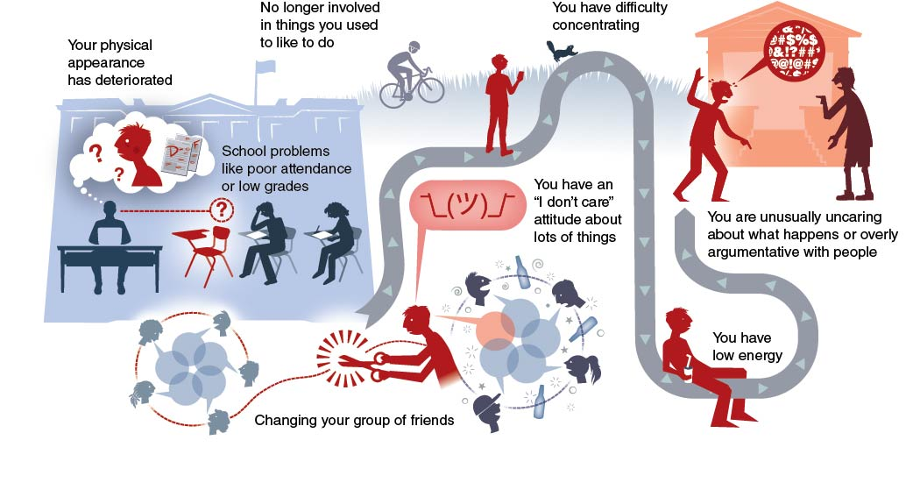
Signs of Alcohol Use
Notes:
Figure 11.3 Signs of teen drinking.

Slide 11
Factors That Influence the Effects of Alcohol
Body size
  The larger a person is, the more drinks it will take to become intoxicated.
How fast the alcohol is consumed
  The faster a person drinks alcohol, the faster they will become intoxicated.
How much a person drinks
  The more a person drinks, the higher the level of alcohol in their bloodstream.

Slide 12
Physical Effects of Alcohol
Short-term effects
  Blurred or double vision
  Increased sweating and flushed skin
  Dehydration
  Nausea, vomiting, and indigestion
Long-term effects
  Risk of brain damage, memory loss, and stroke
  Cardiovascular disease and high blood pressure
  Cirrhosis of the liver (irreversible scarring)
  Inflamed and bleeding stomach lining

Slide 13
Effects of Alcohol During Pregnancy
If a woman drinks alcohol when she is pregnant, her fetus also absorbs the alcohol.
Drinking alcohol during pregnancy can cause miscarriages, stillbirths, and fetal alcohol spectrum disorder (FASD).
  FASD is a group of conditions that can cause a child to have physical, behavior, and learning problems.

Slide 14
Consequences of Alcohol Use
Mental consequences include reduced ability to do simple tasks and impaired brain development.
Social consequences include lost friends, damaged relations with family, and poor school performance.
Legal consequences include a possible charge as a minor in possession (MIP), a misdemeanor punishable by up to one year in jail.

Slide 15
Drinking and Driving
There is zero tolerance for anyone under 21 drinking and driving.
Teenage drivers convicted of driving under the influence (DUI) or driving while intoxicated (DWI) can have their driving licenses suspended or permanently revoked.
Car crashes are the leading cause of death for teens. About a quarter of these crashes involve underage drinking.

Slide 16
Blood Alcohol Content
Blood alcohol content (BAC) is the amount of alcohol in the bloodstream.
BAC indicates how intoxicated a person is.
  Intoxicated means alcohol is affecting the person’s ability to do simple tasks like walking and talking.
In the United States, a person is considered legally impaired or intoxicated if they have a BAC of 0.08 percent or higher.

Slide 17
Skill-Building Challenge
Use the Internet to research the national SADD organization.
Using information from the SADD website, explain how you would advocate for having a SADD chapter at your school.
Explain why a SADD chapter is needed and what message you will use to promote the chapter.

