Slide 1
Treating Alcohol Use Disorders
Live Well: Foundations of High School Health
Chapter 11, Lesson 3

Slide 2
Write About It
List everything you know about treatment for an alcohol use disorder.
Then write questions related to treatment that you would like to have answered.

Slide 3
Can you . . .
Define what an alcoholic use disorder is and how it is diagnosed?
Describe three of the most common reasons for teen alcohol use disorders?
Explain what outpatient treatment is?
Summarize what a residential treatment center is?
Tell what a student assistance program does?
Discuss how family members can be involved in a teen’s treatment program?

Slide 4
Alcohol Use Disorder
Alcohol use disorder (AUD) is a medical condition that is diagnosed when a person’s drinking causes distress or harm.
AUD ranges from mild to moderate to severe.
AUD is diagnosed if a person answers yes to two or more questions from an 11-question list about their drinking experience in the last year.
Severity of the AUD is defined by how many questions a person answers with yes.

Slide 5
Possible Causes of Alcohol Use Disorder in Teens
Genetics factors:
  If a teen has a close family member with an alcohol problem, the teen may be predisposed to find alcohol pleasurable, despite bad effects.
Psychological factors:
  Teens who have anxiety and depression, or who are impulsive and risk taking, may develop AUD.
Social factors:
  Teens with friends who drink regularly or who are influenced by media or peers may develop AUD.

Slide 6
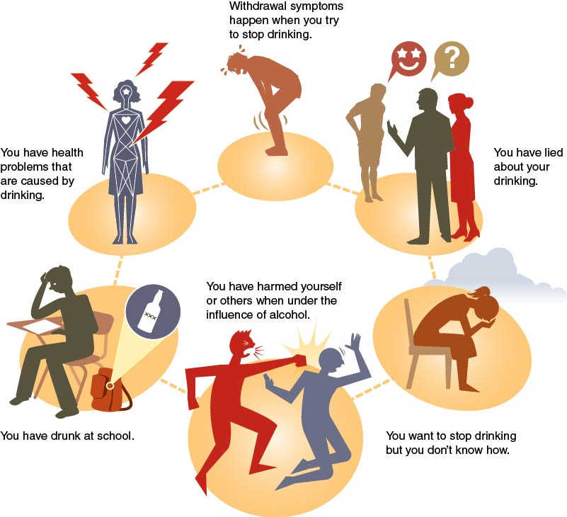
Signs You May Need Help for Alcohol Use Disorder
Notes:
Figure 11.10 Indications that help may be needed for an AUD.

Slide 7
Getting Help for an Alcohol Use Disorder
Get help for an AUD when you or a friend begin to realize you lack energy and don’t want to do things you used to like.
Get help when you start having problems
  at school (not turning in assignments),
  at home (fighting with guardians or siblings),
  with other people (disagreements with friends), and
  with law enforcement (new or ongoing problems).

Slide 8
Helping Friends or Family Who Have an Alcohol Use Disorder
If your friend or family member has an alcohol use disorder, they need help.
It is important for you to talk with someone concerning your friend or family member.
Talk with the person who has the problem when they are sober. Use I messages.
Express your concern for them instead of accusing them of drinking too much or too often.

Slide 9
Alcohol Treatment Programs
An alcohol treatment program is where people go to get professional help for an alcohol use disorder.
Based on the severity of the AUD and the individual’s needs, multiple programs can help people stop drinking.

Slide 10
Outpatient Treatment for AUD
Outpatient treatment centers allow students to go to school and live at home, but they have to attend counseling on a pre-determined basis.
Types of outpatient treatment include the following:
  Individual counseling
  Group therapy
  Mutual support groups
  School-based student assistance programs

Slide 11
Residential Treatment Centers for AUD
A residential treatment center is where an individual would live full time for the length of their treatment for an AUD.
Length of treatment averages about one to three months.
Residential treatment centers also want the family involved in the alcohol user’s treatment.
  The programs examine how family dynamics may help or hurt the user once they return home.

Slide 12
Skill-Building Challenge
Use the Internet to locate at least one alcohol treatment program for the following categories:
  Individual counseling with a substance abuse counselor
  Group therapy for teens who use alcohol
  Support group for teens who use alcohol
  Inpatient treatment center for teens who use alcohol.
Do the agencies appear valid and reliable?
Explain using the appropriate skill cues.

