Slide 1
Tobacco Products and Vaping
Live Well: Foundations of High School Health
Chapter 12, Lesson 1

Slide 2
Write About It
Can you name four types of tobacco products?
Can you name the common ingredient found in all forms of tobacco?

Slide 3
Can you . . .
Describe what tobacco is and name its main ingredient?
Explain short- and long-term health effects of tobacco products on a person?
Explain how vaping is as dangerous as smoking?
Examine the impact of secondhand smoke, thirdhand smoke, and secondhand aerosol?

Slide 4
Tobacco and Its Ingredients (1 of 2)
Tobacco is a plant grown for its leaves, which are dried and put into tobacco products.
Tobacco contains nicotine, which is the addictive chemical and the main ingredient in tobacco.
Nicotine stimulates the release of dopamine in the brain, which is the chemical responsible for feelings of excitement, relaxation, and stress relief.
(continued)

Slide 5
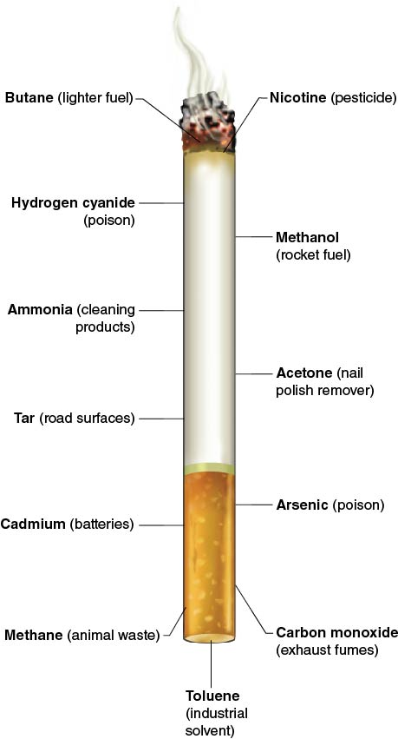
Tobacco and Its Ingredients (2 of 2)
Notes:
Figure 12.1 Common cigarette components and what else they can be found in.

Slide 6
Types of Tobacco Products
Cigarettes
Cigars
Snuff and snus
Electronic cigarettes (e-cigarettes)
Dissolvables
Pipe
Chewing Tobacco

Slide 7
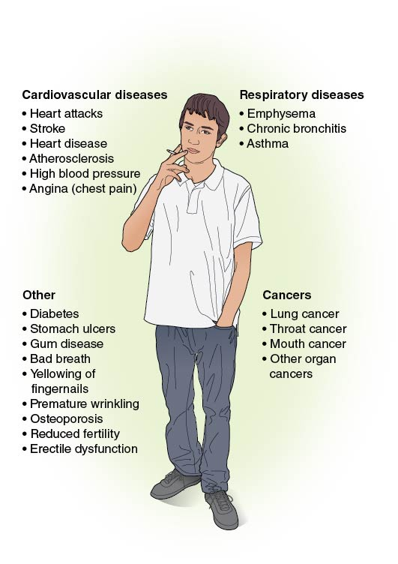
Tobacco’s Effects on the Body
Notes:
Figure 12.3 Effects of tobacco on the body.

Slide 8
Effects of Nicotine on Mental Health
When a person uses nicotine regularly, it can lead to nicotine addiction due to a cycle of increases in dopamine.
People think that nicotine relaxes them and reduces their stress, but actually their stress and anxiety will increase when dopamine decreases.
One of the long-term effects of nicotine use is slowing the brain’s ability to produce dopamine on its own.

Slide 9
Pregnancy and Tobacco Product Use
Women who smoke have more difficulty becoming pregnant than women who don’t smoke.
Men who smoke can have damaged sperm and have difficulty getting their partner pregnant.
Smoking while pregnant can cause many health problems to the mother and her baby.

Slide 10
Health Effects of Smokeless Tobacco
Smokeless tobacco is also a serious risk to your mouth and overall health.
It contains twice as much nicotine as a regular cigarette.
It can cause cancer of the mouth, esophagus, or pancreas.
It destroys gum tissue and causes cavities, tooth decay, and bone loss around the teeth.

Slide 11
E-Cigarettes (1 of 2)
They are also known as e-cigs, vape pens, vapes, mods, tank systems, and ENDS, which stands for electronic nicotine delivery systems.
An e-cigarette is a battery-operated device that heats a liquid and produces an aerosol.
The aerosol that is inhaled and exhaled can contain nicotine, flavorings, ultrafine chemical particles, cancer-causing chemicals, and heavy metals such as nickel, tin, and lead.
(continued)

Slide 12
E-Cigarettes (2 of 2)
Vaping is the act of inhaling and exhaling aerosol produced by an e-cigarette.
The liquid is often referred to as e-juice and usually contains nicotine, flavoring, and other chemicals.
The amount of aerosol produced by the e-cigarette affects how much nicotine is consumed.

Slide 13
Who Uses E-Cigarettes?
E-cigarettes are popular with teens who have never smoked cigarettes before and may never have intended to.
Teens using e-cigarettes are at an increased risk of smoking cigarettes later in life partly because of nicotine addiction.
E-cigarettes may be more socially acceptable than smoking cigarettes because the aerosol does not smell as bad as cigarette smoke.

Slide 14
E-Cigarettes Are a Dangerous Alternative to Smoking
E-cigarettes have been advertised as a safe alternative to smoking and a method to quit smoking cigarettes.
Little evidence shows e-cigarette use reduces smoking or leads to completely quitting smoking.
Vaping an average-sized e-cigarette is equal to 12 cigarettes, and most tobacco cigarettes contain between 8 and 12 milligrams of nicotine.

Slide 15
Health Risks and E-Cigarettes
Since e-cigarettes are fairly new, we still have much to learn about their long-term effects.
  Many of the known health risks are like those for smoking cigarettes.
  It is unclear what all the ingredients are in e-juices, so no one knows what their side effects will be. This information may not be available for years.
  Vaping can cause lung and cardiovascular diseases, lung cancer, and fainting and can reduce the effectiveness of the immune system.

Slide 16
Skill-Building Challenge
Read the scenario about trying vaping in the skill-building challenge in this lesson.
Using the information in this lesson and your decision-making steps, fill out the Skill-Building Challenge worksheet to come to your decision about if Oaklynn should try vaping.

