Slide 1
Avoiding and Quitting Tobacco Product Use
Live Well: Foundations of High School Health
Chapter 12, Lesson 3

Slide 2
Write About It
Why do you think it is so hard for teens to quit using tobacco products once they start?

Slide 3
Can you . . .
Express three ways to stay tobacco-free?
Recognize four signs of nicotine addiction?
Analyze three benefits to being tobacco-free and quitting tobacco products?
Assess different methods for quitting tobacco products and their effectiveness?

Slide 4
Nicotine Addiction
Nicotine is the addictive substance found in all tobacco products.
  It is poisonous when used in its pure form.
  When you inhale, your brain releases epinephrine, or adrenaline, causing your heart rate and blood pressure to increase.
  Your brain also release dopamine, which is the hormone linked to feelings of happiness, motivation, and concentration.
Users get addicted to the nicotine, not the tobacco products.

Slide 5
Tips for Staying Tobacco-Free
Stay away from situations where tobacco products may be used.
Spend time with friends who don’t use tobacco products.
Create a plan or things to say to help you get out of the situation.

Slide 6
Refusal Skills to Avoid Tobacco Use
Refusal skills are techniques you use to say no to something you don’t want to do.
To say no to tobacco products, use a combination of verbal and nonverbal communication to get your point across.
Make sure your verbal response is firm and confident and your nonverbal response matches it.

Slide 7
Benefits of Being Tobacco-Free (1 of 2)
You no longer have to find places and times to smoke.
You will have more money.
Your skin and nails will look healthier, your teeth will look whiter, and your breath will be fresher.
You will have more energy.
You’ll be able to do normal activities without losing your breath.
You will not expose others to secondhand smoke.
(continued)

Slide 8
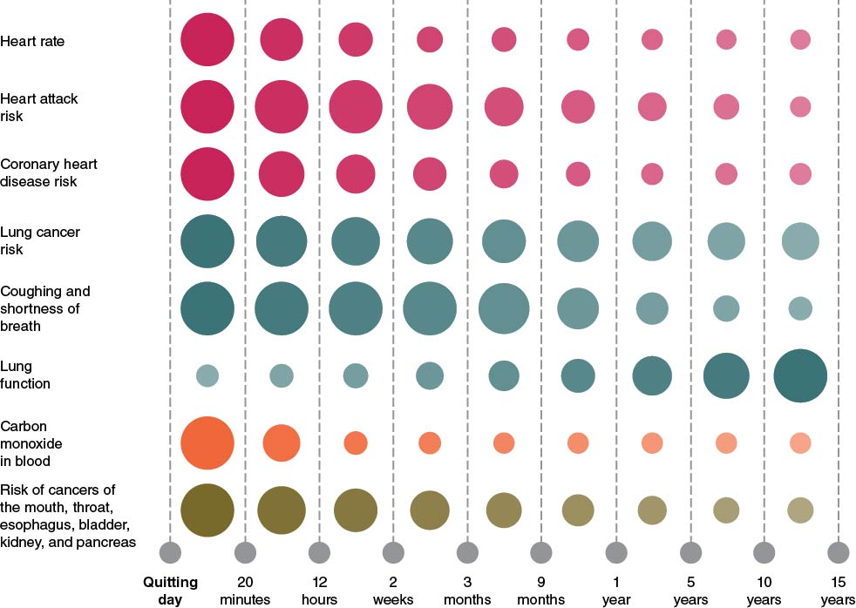
Benefits of Being Tobacco-Free (2 of 2)
Notes:
Figure 12.10 Quitting smoking and the effects on the body.

Slide 9
Quitting Methods (1 of 2)
Quitting isn’t easy, and there may be times when you aren’t completely successful. But having a plan will help you get back on track.
To be successful at quitting, do the following:
  Set a quit date.
  Make a list of reasons why you want to quit.
  List the triggers that make you want to use a tobacco product.
  Have a plan to fight the cravings and get rid of all the smoking reminders.
  Keep trying to quit until you meet your goal.
  (continued)

Slide 10
Quitting Methods (2 of 2)
Use apps and text message programs to help with quitting.
Consider nicotine replacement therapy (NRT).
  The patch, gum, inhalers, lozenges, nasal sprays
Seek individual, group, or telehealth counseling.
Exercise, use deep breathing techniques, or meditate.
Get support from family and friends

Slide 11
Skill-Building Challenge
Your friend has just offered you an e-cigarette. You do not want to offend them by refusing, but you also do not want to vape.
Write a script between you and your friend that includes at least three health reasons why you would not want to vape.
Include in your script I messages and refusal skills to reinforce your use of the word no.

