Slide 1
Over-the-Counter and Prescription Drugs
Live Well: Foundations of High School Health
Chapter 13, Lesson 1

Slide 2
Write About It
Explain why teens may use a friend’s prescription medicine.

Slide 3
Can you . . .
Compare and contrast the similarities and differences between over-the-counter and prescription medications?
Explain the general purpose of a drug facts label?
Describe why teen use of prescription drugs is one of the major drug problems in the United States?
Analyze why teens might continue using OTC and prescription drugs other than the way they should be used?

Slide 4
Medicine and Drugs
Medicine is the science of diagnosing and preventing disease and maintaining health.
Medicine can also be defined as a drug used to maintain health or treat a health issue.
Drugs can ease symptoms, help prevent or manage diseases, relieve pain, and treat multiple conditions.
Drugs are divided into two categories: nonprescription or over-the-counter (OTC) drugs and prescription drugs.

Slide 5
Comparing OTC and Prescription Drugs
OTC drug | Prescription drug
Does not require a doctor’s prescription | Prescribed by a doctor
Bought off the shelf in stores | Bought at a pharmacy
Can be used by more than one person | Prescribed for and to be used by only one person
Regulated by the FDA | Regulated by the FDA

Slide 6
Using OTC and Prescription Drugs Safely
The U.S. Food and Drug Administration (FDA) is the government agency that decides which drugs require a prescription and which may be sold over the counter.
To use an OTC drug safely means using the drug properly.
To use prescription drugs safely, it is important to use them as they are prescribed by your doctor.

Slide 7
Reading Drug Labels
In the United States, every OTC and prescription drug has a drug facts label.
The general purpose of the label is to tell you what the drug is used for and how to use it safely.
Taking a drug as prescribed will make sure it works the way it is supposed to.

Slide 8
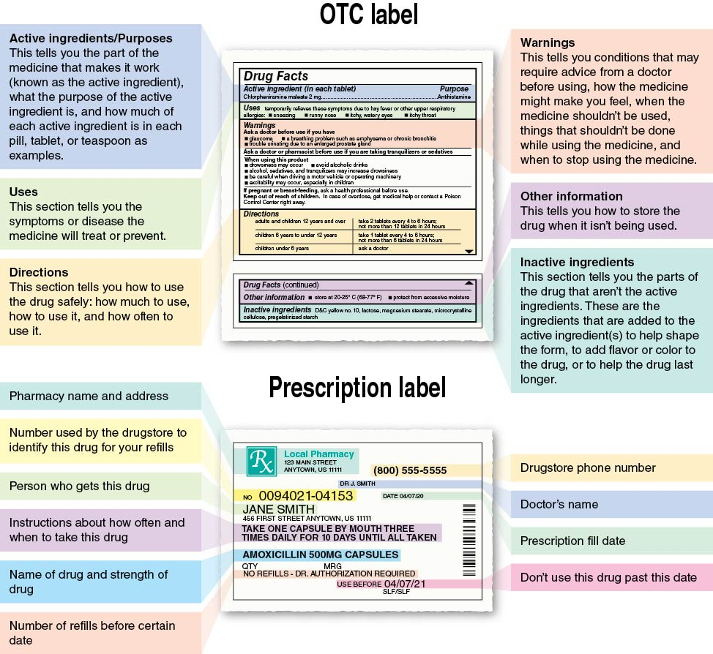
OTC and Prescription Labels
Notes:
Figure 13.1 Both OTC and prescription drugs require drug facts labels.

Slide 9
Safe Storage and Disposal
OTC and prescription drugs should be stored in a cool, dry place such as in a drawer or cabinet away from heat and moisture.
Prescription and OTC drugs should always be kept in their original containers, so it is clear as to what they are.
When OTC and prescription drugs expire or are no longer needed, they should be disposed of properly.
  Drop off medicines at a drug take-back site.

Slide 10
Potential Risks of Taking OTC and Prescription Drugs
Side effects: These may include nausea, dizziness, dry mouth, and drowsiness.
Drug–drug interactions: Using two drugs together affects how your body processes them.
Drug–food interactions: What you eat and drink can prevent a drug from working as it should.
Allergic reactions: Signs may include itching, hives, and breathing problems.

Slide 11
Abuse of OTC and Prescription Drugs
Prescription drugs are the fourth most commonly abused substance by teens, after alcohol, marijuana, and tobacco or vaping.
Commonly misused OTC and prescription drugs include
  cough syrup,
  cold medicine,
  Adderall and Ritalin, and
  Vicodin and OxyContin.

Slide 12
OTC Performance-Enhancing Drugs
Performance-enhancing drugs are substances used to improve athletic performance.
Caffeine is a stimulant most often found in coffee and energy drinks.
  It may be used by athletes to speed up the central nervous system and increase heart rate and blood pressure.
Your body produces creatine, which helps muscles release energy.

Slide 13
Diet Pills
Diet pills often come with a large promise of significant weight loss.
Diet pills may help with weight loss, but they can also have health risks.
OTC diet pills are marketed to help you lose weight by increasing your metabolism.
The primary ingredient of most diet pills is caffeine, but they may have other ingredients that may or may not be safe.

Slide 14
Skill-Building Challenge
You have just heard that one of your classmates got arrested for selling her ADHD pills to some other students at school. The students were buying the pills to help them study for finals.
You want to advocate for the students and their families to be aware of what is happening and to use prescription drugs properly.
Use the Advocacy Skill Cues to complete the challenge.

