Slide 1
Illicit Drugs
Live Well: Foundations of High School Health
Chapter 13, Lesson 2

Slide 2
Write About It
Write the slang terms for any illicit drug you can think of.

Slide 3
Can you . . .
Differentiate between a prescription drug and an illicit drug?
Identify the different types of drugs based on a description?
Explain why some teens use illicit drugs?
Recognize five warning signs of teen drug use?

Slide 4
Illicit Drugs and Drugs of Abuse
Illicit drugs are substances that are illegal to possess, have no medical applications, and can be dangerous to consume.
They stimulate or slow the central nervous system or cause hallucinogenic effects.
Illicit drugs are dangerous because they are unregulated, so their potency is often unknown.

Slide 5
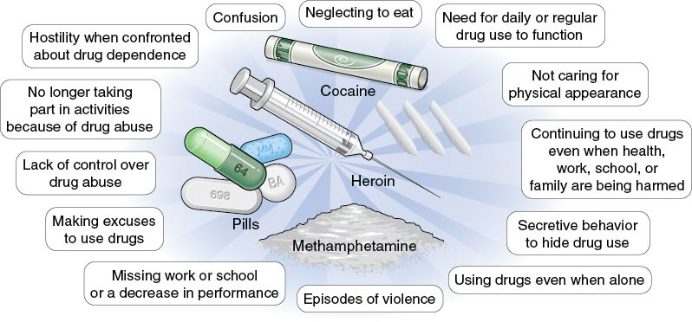
Possible Effects of Using Drugs
Notes:
Figure 13.3 Effects of using illicit drugs.

Slide 6
Marijuana (1 of 2)
Marijuana (also known as cannabis) is one of the most popular drugs and is commonly used by smoking or vaping or consumed as edibles.
  Its main ingredient is tetrahydrocannabinol (THC), which produces the psychoactive “high.”
  Short-term side effects may include being overly relaxed, increased appetite, and impaired judgment.
  Long-term side effects may include mental health problems such as marijuana use disorder.
  (continued)

Slide 7
Marijuana (2 of 2)
Marijuana is currently legal in many U.S. states and in the District of Columbia for people over the age of 21.
Some states have approved medical marijuana only, and other states have approved adult-use recreational marijuana.
It is still illegal to use marijuana according to the federal government.

Slide 8
Stimulants
Stimulants speed up the body’s systems.
This class of drugs includes the following:
  Prescription drugs such as amphetamines used to treat ADHD
  OTC diet pills
  Illicit drugs such as cocaine and methamphetamine
Stimulants can be snorted, smoked, injected, or taken as a pill.

Slide 9
Cocaine and Methamphetamine
Cocaine is a white, crystalline powder derived from coca leaves.
  Crack cocaine, another common form, looks like small, unevenly shaped white rocks.
  Cocaine makes the user feel energetic, alert, and overly sensitive to sights and sounds.
Methamphetamine, or meth, is one of the most common illegal drugs in the United States.
  It can be made easily from OTC ingredients in cold medicines.
  Meth creates a pleasurable feeling of excitement due to the release of high levels of dopamine.

Slide 10
Opioids (1 of 2)
Opioids, or narcotics, are naturally found in the opium poppy plant.
This class of drugs includes the illicit drug heroin as well as pain relievers available by prescription, like oxycodone, hydrocodone, and morphine.
Synthetic opioids, such as fentanyl, are made in a lab.
Opioids are often used as medicine because they contain chemicals that relax the body and relieve pain.
(continued)

Slide 11
Opioids (2 of 2)
Opioids are powerfully addictive drugs.
While prescription opioids can be highly effective for pain relief, if not used properly, they can result in addiction, overdose, and death.
Misuse and addiction to opioids is a national crisis that affects people of all ages, ethnicities, and incomes.

Slide 12
Inhalants
Inhalants are invisible, dangerous substances found in common household products that are inhaled as vapors through the nose or mouth.
The high they produce usually lasts only a few minutes.
  Examples of inhalants include felt-tip markers, spray paint, hairspray, nail polish remover, and gasoline.
  Short-term effects include slurred speech, lack of coordination, headaches, and dizziness.
  Long-term effects can include loss of coordination and brain damage, and may result in death.

Slide 13
Steroids
Anabolic steroids are a lab-created version of the male hormone testosterone.
They are used illegally to promote muscle growth, enhance athletic performance, and improve physical appearance.
Steroid use can have many side effects:
  Men: shrinking testicles, decreased sperm production, mood swings, and aggression
  Women: deepening of the voice, decrease in breast size, increase in face and body hair

Slide 14
Hallucinogens
Hallucinogens are among the oldest known group of drugs used for their ability to alter human perception and mood.
They are found in plants and mushrooms but can also be manufactured.
They cause hallucinations.
Three main examples of hallucinogens include
  LSD,
  PCP, and
  mescaline.

Slide 15
Club Drugs
Club drugs are primarily used by teens and young adults at parties, concerts, and clubs.
The most common club drugs are in two drug classes: hallucinogens and depressants.
  Hallucinogens alter perception and mood.
  They include ecstasy, GHB, and LSD.
  Depressants can calm nerves, relax muscles, and help you sleep.
  Benzodiazepines help you sleep and relieve anxiety.
  Rohypnol, called the date rape drug, is a depressant that is easily slipped into someone’s drink.

Slide 16
Depressants
Depressants are useful for treating anxiety, stress, and sleep disorders.
Effects on the body include muscle relaxation, loss of motor coordination, weakness, and slurred speech.
Extended use of depressants can lead to a physical dependence on the drug.
Examples include the following:
  Benzodiazepines such as Ativan, Valium, and Xanax.
  Non-benzodiazepine sedative-hypnotics such as Ambien and Lunesta
  Barbiturates
  Benzodiazepines
  Rohypnol

Slide 17
Why Some Teens Use Illicit Drugs
To fit in and be accepted by peers
Are curious
To feel good or experience pleasure
Have low self-esteem
To feel better or to forget
To do better in competition
To overcome feelings of boredom
To cope with problems

Slide 18
Drug Use and School Performance
Teens who use and abuse drugs have lower grades, higher absence rates, and are more likely to drop out of school.
Teens who drop out of school are more likely to use cigarettes, alcohol, marijuana, and other illicit drugs.
Marijuana use in high school students slows the development of judgment, reasoning, and complex thinking.

Slide 19
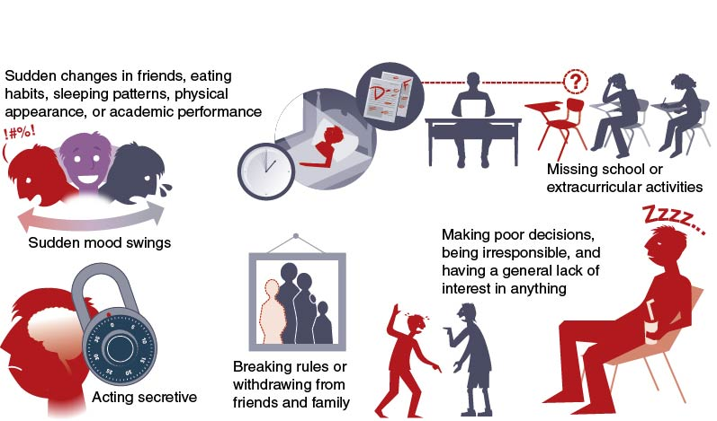
Potential Signs of Teen Drug Use
Notes:
Figure 13.5 Potential signs of drug use.

Slide 20
Skill-Building Challenge
You go to a big party where your friends are smoking weed and encouraging you join them.
You know you shouldn’t smoke weed, but your friends are starting to put a lot of pressure on you to give it a try. What do you do?
Using the decision-making steps on page 573, write out your response to each of the steps.

