Slide 1
Influences on the Use of Drugs
Live Well: Foundations of High School Health
Chapter 13, Lesson 3

Slide 2
Write About It
Who or what is your most positive influence and why?
Who or what is your most negative influence and why?
Which external influencing factors have the greatest impact when it comes to making significant decisions in your life?
Why are they so important to you?

Slide 3
Can you . . .
Identify three factors that influence teens to use drugs?
Explain the three pieces of information that drug ads are required to tell consumers?
Evaluate three techniques marketers use to influence teens to purchase items?
Devise three healthy alternative activities that are spontaneous and three healthy alternative activities that require planning?

Slide 4
Factors That Influence the Use of Drugs
Family influence, such as a sibling using drugs
Peer influence, or friends who use drugs
Media influence, or magazines, radio, and TV
Social media influence, or celebrities on Snapchat or Instagram
You as an influence, or deciding to use drugs
Life influence, or transition periods when drug use may occur

Slide 5
Advertising Techniques and Their Influence on Teens
(1 of 2)
Making interesting commercials
Engaging teens by incorporating an experience in the ad such as games, apps, and contests
Using emotions to have teens identify with a product
Taking advantage of teen insecurities by appealing to their need to fit in and to be viewed as attractive, athletic, or popular
(continued)

Slide 6
Advertising Techniques and Their Influence on Teens
(2 of 2)
Using celebrities and athletes to endorse their products
Using message that imply everyone is doing it
Tracking teens’ digital trail to determine their interests, purchases, preferences, and even location
Using peer influence on social media by having teen followers market their products for them

Slide 7
Healthy Alternatives to Substance Use (1 of 2)
Teens need to realize there are always other things to do besides drugs; sometimes they just need to think about it ahead of time.
When teens are engaged in productive and healthy activities such as sports, volunteering, and youth groups, they are much less likely to turn to drugs for recreation.
(continued)

Slide 8
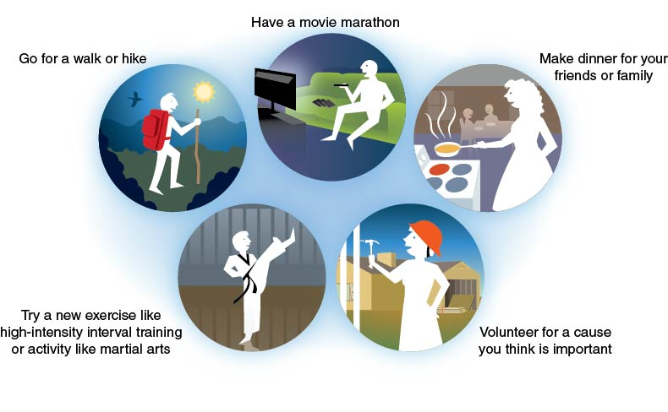
Healthy Alternatives to Substance Use (2 of 2)
Notes:
Figure 13.7 Some suggestions for healthy alternative activities to drugs. There are many more ideas you can come up with based on where you live and the options you have.

Slide 9
Skill-Building Challenge
Advertisers target teens daily through multiple media outlets.
Recall that external factors and internal factors influence your purchase of a product.
Using at least two different media sources for information, find two advertisements: one for an OTC medication and one for a prescription drug. Use the information to complete the chart.

