Slide 1
Safety in the Community
Live Well: Foundations of High School Health
Chapter 14, Lesson 2

Slide 2
Write About It
Whether it was you driving or you were a passenger in the vehicle, have you ever been in an accident because the person driving was reading or responding to a text?
Did it make you rethink your behavior in the situation—either not to text and drive or to tell the driver not to text? Why or why not?

Slide 3
Can you . . .
Explain three actions schools are taking to be safer and more prepared for dangerous situations?
Discuss three ways to stay safe in a public place?
Analyze why male teens, teens driving with teen passengers, and teens who have just obtained their license are the three groups at the highest risk for a motor vehicle crash?
Identify three ways to stay free of injuries at a job?

Slide 4
Community Safety
A community is a group of people with a common interest participating in similar activities or having similar experiences.
Your community includes your school, public places you go to, your home, and the online community of your social media.
Community safety involves reducing injuries, practicing safe behaviors, and working to change unsafe situations.

Slide 5
School Safety
Schools are taking action to be safer and more prepared for dangerous situations:
  Teaching problem-solving and communication skills so students can better handle their emotions
  Improving school designs with well-lit hallways that have convenient exits
  Locating office areas centrally for easy access
  Locking all outside doors so visitors must enter through one main door and show identification to get in

Slide 6
Active Shooter Situations
An active shooter is an individual actively engaged in killing or attempting to kill people in a populated area.
The appropriate active shooter response is to:
  run from the shooter,
  hide, if escape is not possible, and
  fight as a last resort and only if your life is in danger.

Slide 7
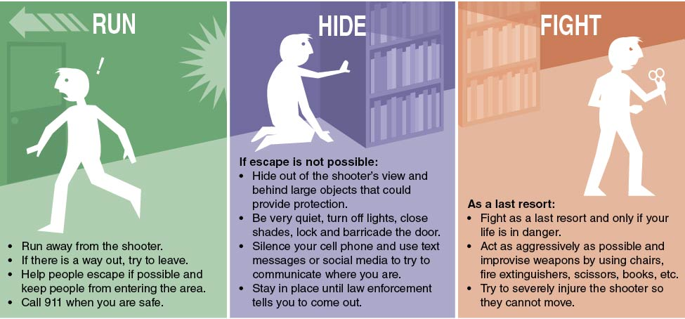
Active Shooter Procedures
Notes:
Figure 14.2 Active shooter procedures.

Slide 8
Public Safety
The following tips tell how to stay safe in public places:
  Be aware of where you are and who is around you.
  Always tell your guardian where you’re going and whom you are with.
  Never talk to strangers or accept rides.
  Be alert for suspicious people or vehicles.
  Avoid walking alone at night.
  Always have your charged cell phone with you.
  Carry only as much cash as you need.
  Trust your judgment and leave a location if you feel uncomfortable.

Slide 9
Pedestrian and Bicycle Safety
Wear bright clothing and reflective gear so you are easily seen.
Look both ways several times before crossing a road and cross only at corners, intersections, or marked crosswalks.
If there is no sidewalk, walk on the shoulder on the left side of the road facing traffic.
When riding a bike, wear a properly fitting bicycle helmet to reduce head and brain injuries if there is a crash.

Slide 10
Motor Vehicle Safety
Teen drivers are almost three times more likely to be involved in a fatal crash than drivers aged 20 or older.
Graduated Driver Licensing (GDL) provides a longer period to practice driving, limit driving at night, and minimize high-risk driving situations for new drivers.
Wearing a seatbelt is the law and the easiest way to reduce chances of serious injury or death while driving or riding in a car.

Slide 11
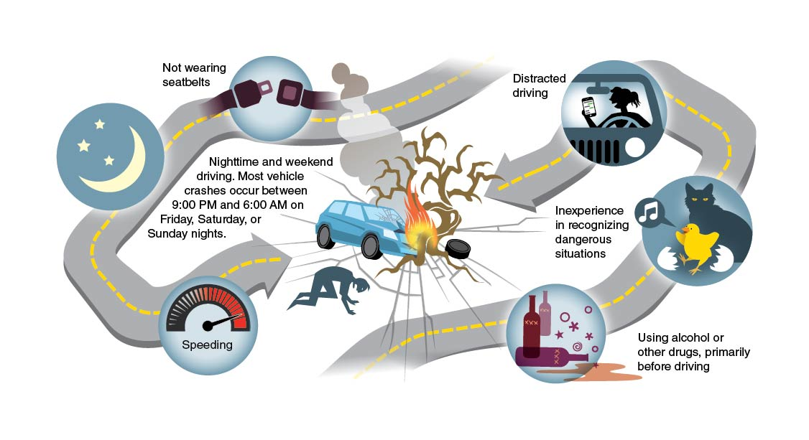
Risk Factors for Teens in Motor Vehicles
Notes:
Figure 14.5 Risk factors for teens in motor vehicles.

Slide 12
Driving Hazards to Avoid
Distracted driving, such as using a cell phone, eating and drinking, or adjusting the stereo while driving
Aggressive driving, such as speeding, tailgating, weaving in and out of traffic, or passing where it’s prohibited
Driving under the influence of alcohol or drugs (also called DUI)
Driving while drowsy, or without enough sleep

Slide 13
Staying Safe at Work
Your employer is responsible for keeping the work environment safe.
To stay safe at work, follow these tips:
  Know the labor laws for your age and state.
  Make sure you are properly trained (ask questions).
  Be alert for potential hazards in the workplace.
  Wear proper safety gear if applicable.
  Know and follow all safety rules and instructions.
  Never interfere with moving machinery.

Slide 14
Water Safety
Always swim with a friend and in areas with a lifeguard.
Wear a U.S. Coast Guard–approved life jacket when swimming if you are inexperienced or on a boat of any kind.
Don’t dive into shallow water or water you cannot see into.
When swimming in a lake, river, or an ocean, avoid swimming in really cold water and watch out for currents.

Slide 15
Helping a Drowning Person
Reach out and have them grab your hand or arm so you can pull them to the edge.
Make sure someone is holding on to you so you don’t get pulled in.
Throw a life ring or buoy or extend a pool noodle for the person to grab onto so you can pull them to the edge.

Slide 16
Skill-Building Challenge
Use the Internet to find resources that provide valid and reliable information in your city or town for the following situations:
  Which intersections or areas have the most and least vehicle–pedestrian accidents?
  Which intersections or areas have the most and least vehicle–bicycle accidents?
  What times of day or night are the safest and least safe for taking public transportation?
  Which ride-hailing service in your area has the best safety record?

