Slide 1
Safety Online
Live Well: Foundations of High School Health
Chapter 14, Lesson 3

Slide 2
Write About It
List at least three ways you could be safer online in general or on specific social media.

Slide 3
Can you . . .
Evaluate how small or large your digital footprint is based on your online activity?
Explain why it is important to know your social media privacy settings?
Describe what identity theft is and how it can affect you?
Examine the effectiveness of your passwords and change them if needed?

Slide 4
Internet Safety
The Internet enables you to search for information, get help with homework, listen to music, stream shows and movies, and interact on social media.
By engaging in all this online activity, you leave a digital footprint, which is a record of your searches and personal information.
Other risks you should be aware of include social media sharing, identity theft, and phishing attacks.

Slide 5
Social Media Sharing
Social media sharing is when you share your current location through pictures or checking in to a specific building or event.
It is easy for social media criminals to see where you are—and where you aren’t (leaving your home vulnerable to break-ins).
Avoid tagging yourself at certain locations.
Check the privacy settings on your phone and the various social media platforms you use.

Slide 6
Identity Theft
Identity theft occurs when someone uses your identity or personal information without your permission in order to commit a crime.
If your identity is stolen, you may not know it until you are older and your application for a student loan or credit card is denied because of maxed-out cards or unpaid bills.
Make sure your computer and cell phone are protected with a password, fingerprint scan, or facial recognition.

Slide 7
Phishing Attacks
Phishing attacks involve dishonest websites, apps, or emails that look legitimate but are not.
Phishing attacks often appear as a link in an email that you are asked to click on to fix a problem with your password or a credit card.
The link takes you to a website that looks real. When you log in, all your personal information has been given to the attacker.
A phishing attack can also corrupt your computer files and make your data vanish.

Slide 8
Importance of Passwords
Many of the hacks to your social media, email, and online sites are due to weak or stolen passwords.
Passwords should be complex and multiple types of characters, including numbers, letters, and symbols.

Slide 9
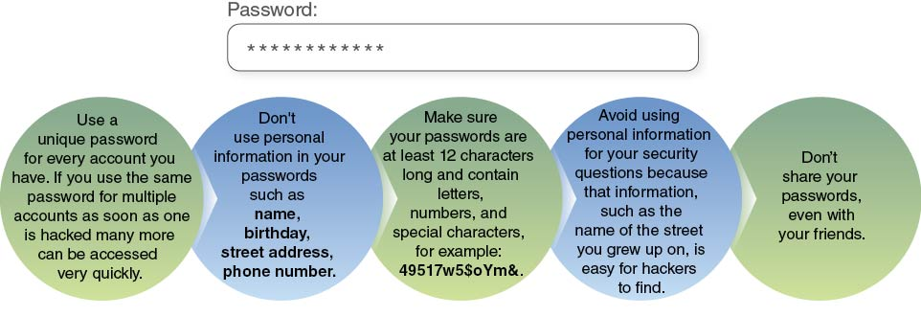
Password Tips
Notes:
Figure 14.7 Tips for creating a strong password.

Slide 10
Technology Safety Tips
Don’t click on unfamiliar links or apps, as they often spread malware, which is a computer virus that invades your computer system.
Think before you share your location.
Don’t accept friend requests from people you don’t know in real life.
Use antivirus software to detect, prevent, and remove malware.
Don’t meet people in person that you know only from being online.

Slide 11
Skill-Building Challenge
Answer the following questions about your social media habits.
  What social media do you use?
  Why do you use social media?
  What do you do on social media to help you stay safe? What do you do that might not be safe?
  What could you do to make your behavior safer?
Log your social media behaviors for one or two weeks and reflect on how, or if, your behaviors improved and became healthier.

