Slide 1
First Aid and Emergency Procedures
Live Well: Foundations of High School Health
Chapter 14, Lesson 4

Slide 2
Write About It
What steps would you take if your guardian said they weren’t feeling well and suddenly collapsed onto the floor?

Slide 3
Can you . . .
Practice each of the emergency action steps?
Explain why you should use universal precautions?
Describe the steps to giving cardiopulmonary resuscitation (CPR)?
Identify the common signs of a sudden illness?
Distinguish the differences between closed and open wounds?
Describe two memory and thinking issues of a person with a concussion?

Slide 4
Preparing for Emergencies
An emergency is an unexpected situation that requires immediate action.
The first thing you should do is call 911.
In an emergency, you may be able to provide first aid, which is providing basic medical care to someone experiencing a sudden injury or illness.
Having a first aid kit on hand is one way you can be prepared for an emergency.

Slide 5
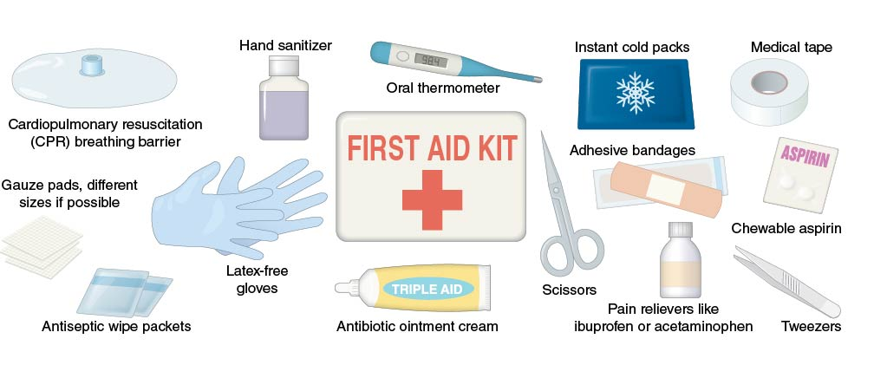
First Aid Kit Basics
Notes:
Figure 14.8 First aid kit basics.

Slide 6
Emergency Action Steps
In any emergency situation, use the emergency action steps of check, call, care.
  Check the scene to make sure it is safe and check the person to determine what the illness or injury might be.
  Call 911.
  Care for the person according to the conditions you find and your level of knowledge and training.

Slide 7
Universal Precautions
Take steps to reduce the risk of transmitting pathogens from one person to another through close physical contact or through a contaminated surface or object.
Help protect a person from bloodborne pathogens such as human immunodeficiency virus (HIV) infection and hepatitis B, C, and D.
Wear gloves, masks, gowns and other personal protection equipment.

Slide 8
Cardiac Emergencies
The two most common cardiac emergencies are heart attack and cardiac arrest:
  Heart attack: occurs when blood flow to part of the heart muscle is blocked
  Cardiac arrest: occurs when the heart stops beating or beats too ineffectively to circulate blood to the brain
Cardiopulmonary resuscitation (CPR):
  Used when a person is not breathing and doesn't have a heartbeat
  Uses chest compressions and rescue breaths to keep oxygenated blood moving to the brain and other organs until advanced medical help arrives

Slide 9
Sudden Illness
Examples of sudden illness include asthma, allergic reactions and anaphylaxis, diabetic emergencies, seizures, and fainting.
Sudden illness often happens with little or no warning.
Symptoms may include
  trouble breathing,
  dizziness,
  blurred vision or slurred speech, and
  numbness or weakness.

Slide 10
Choking Emergencies
Occur when the airway becomes either partially or completely blocked
Signs and symptoms:
  Placing hands around throat (most common sign)
  Trying to cough but unable to
Care:
  Give five back blows and five abdominal thrusts.
  Continue the back blows and abdominal thrusts if the person becomes unresponsive or until they can cough forcefully, speak, and breathe.

Slide 11
Heat-Related Emergencies
Caused by overexposure to heat and hydration
Heat cramps: painful muscle spasms
Heat exhaustion: more severe than heat cramps
Heatstroke: most severe and least common

Slide 12
Cold-Related Emergencies
Caused by overexposure to cold
Frostbite: freezing of the skin and underlying tissues as a result of prolonged exposure to freezing or below freezing temperatures
Hypothermia: lowering of the body’s core temperature to a point at which body function becomes impaired

Slide 13
Burns
Burns are caused by contact with extreme heat, chemicals, radiation, or electricity.
Burns are classified by how deep they are; the deeper the burn, the greater the severity.
A sunburn is a heat-related emergency and a type of burn that is caused by overexposure to the sun.

Slide 14
Wounds
Wounds are injuries that result when the skin or other tissues of the body are damaged.
The two types are closed and open wounds:
  Closed wounds: bruises, internal bleeding
  Open wounds: abrasions, lacerations, avulsions, amputations, punctures

Slide 15
Muscle, Bone, and Joint Injuries
Sprains result from a stretched or torn ligament.
Strains result from a stretched or torn tendon or muscle.
Dislocations occur when bones that meet at a joint move out of their normal position.
Fractures are a complete break, chip, or crack in a bone.

Slide 16
Head, Neck, and Spinal Injuries
These injuries are very serious and can leave a person with a permanent disability.
A concussion is a common type of traumatic brain injury that involves a temporary loss of brain function.
Spinal cord injuries occur when bone fragments from vertebrae press into the soft tissue of the spinal cord or the soft tissue of the spinal cord swells, compressing it against the vertebrae.

Slide 17
Skill-Building Challenge
Practice what you would say if you had to call 911 in the following situations:
  A friend suddenly stands up and grabs her throat. She isn’t speaking or making any sound.
  You and a friend are out for a jog when he begins complaining about difficulty breathing and chest pains. He suddenly falls to the ground.
  Your teammate passes out at practice on a hot day in summer. Her skin is pale and feels clammy.
Practice your call to 911 and then explain the steps you would take while waiting for EMS to arrive.

