Slide 1
Air, Water, and Noise Pollution
Live Well: Foundations of High School Health
Chapter 15, Lesson 1

Slide 2
Write About It
In what ways do air, water, and noise pollution affect your health?
Provide specific examples in your explanation.

Slide 3
Can you . . .
Explain how air pollution can affect personal and community health?
Understand influences on health by identifying four common sources of indoor air pollution?
Analyze two causes of water pollution and how individual actions influence community health?
Explain how individual choices can affect health risks associated with noise pollution?
Analyze influences on air and water pollution?

Slide 4
Air Pollution and Your Health
Air pollution occurs when the air contains dangerous particles such as particulates, carbon monoxide, and carbon dioxide.
Air pollution can trigger asthma and allergy attacks; sleepiness; headaches; and irritation of the eyes, nose, throat, and skin.
Air pollution is particularly dangerous for
  children,
  older adults (over age 65), and
  people with respiratory infections or diseases.

Slide 5
Outdoor Air Quality
Natural forces in the environment and human activity influence outdoor air.
Smog is the combination of moisture in the air that has mixed with smoke and chemical fumes.
  Smog can harm the lining of the lungs and respiratory tract and irritate the eyes.
Acid rain is caused when chemicals that are released into the air mix with water and oxygen to form acids.

Slide 6
Indoor Air Quality
Indoor air quality refers to how polluted the air is inside buildings, including your school.
Here are the best ways to improve indoor air quality:
  Keep things clean, including bedding, clothing, curtains, and furniture.
  Keep air filters clean in heating and cooling units.
  Use chemical-free cleaning products.
  Use an air purifier.
  Let in fresh air when outdoor air quality is good.

Slide 7
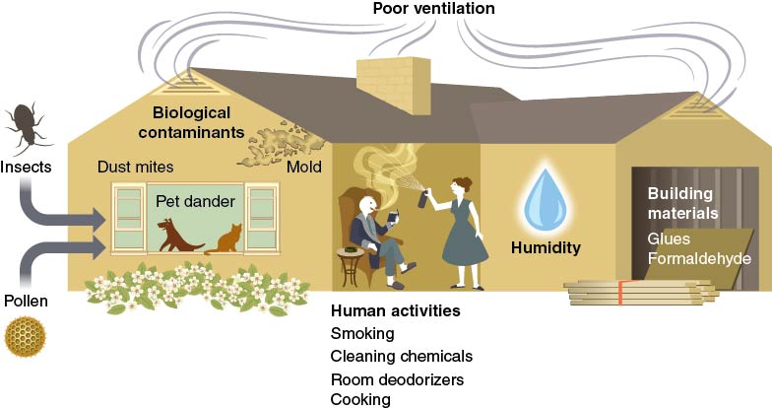
Sources of Indoor
Air Pollution
Notes:
Figure 15.4 Sources of indoor air pollution.

Slide 8
Water Pollution and Your Health
Potential causes of water pollution include the following:
  People using chemicals on lawns, washing the car in the driveway, and using weed killers
  Chemicals used in manufacturing products
  Improper disposal of products containing chemicals (paint, batteries, and medicines)
  Microorganisms from animals and human waste and garbage or food waste
  Natural disasters

Slide 9
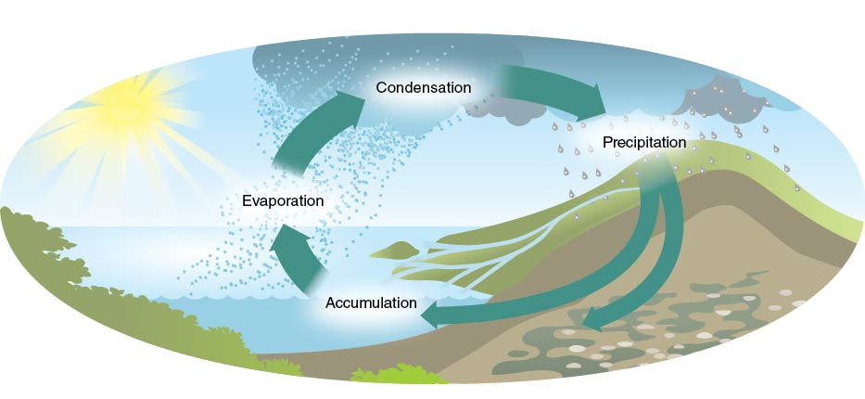
The Water Cycle
Notes:
Figure 15.6 The water cycle.

Slide 10
How to Keep the Water Supply Safe
Don’t put anything except water down storm drains, including sinks and toilets.
Avoid using pesticides and chemical fertilizers.
Choose nontoxic household products.
Don’t flush unused medicines down the toilet or drain.

Slide 11
Noise Pollution and Your Health
When sound is unwanted, excessive, or bothersome, it is called noise pollution.
  Can damage hearing
  Can cause high blood pressure, sleep difficulties, and poor performance at school or work
A major source of noise comes from earbuds and headphones worn with personal devices.
An estimated one in five teens have developed mild hearing loss.
  Reduce the volume on personal devices to protect your hearing.

Slide 12
Skill-Building Challenge
Write down all the different ways humans might pollute the air and water in your community.
Rank-order the items, with the most common behavior at the top and the least common at the bottom.
Answer these questions:
  Why do you think people make choices that pollute the environment?
  How might these choices influence the health of individuals in your community?

