Slide 1
Chemicals, the Environment, and Your Health
Live Well: Foundations of High School Health
Chapter 15, Lesson 2

Slide 2
Write About It
Have you ever considered whether the personal care products you use are safe?
How would you feel if you found out that your shampoo, soap, or sunscreen contained dangerous ingredients?
Would you try to change the products you use?

Slide 3
Can you . . .
Explain the dangers of toxic chemicals?
Explain how to identify toxic chemicals in personal care products?
Explain three ways to reduce your exposure to toxic chemicals found in household items?
Explain what to do if you are exposed to toxic chemicals?

Slide 4
What Are Chemicals?
A chemical is a substance that cannot be broken down without changing into something else.
Chemicals can occur naturally (gold found in rocks or vitamin C found in citrus fruits) or be human-made (synthetic chemicals).
A toxic chemical is any chemical that can cause death, make you pass out for a period of time, or cause permanent harm to humans or animals.

Slide 5
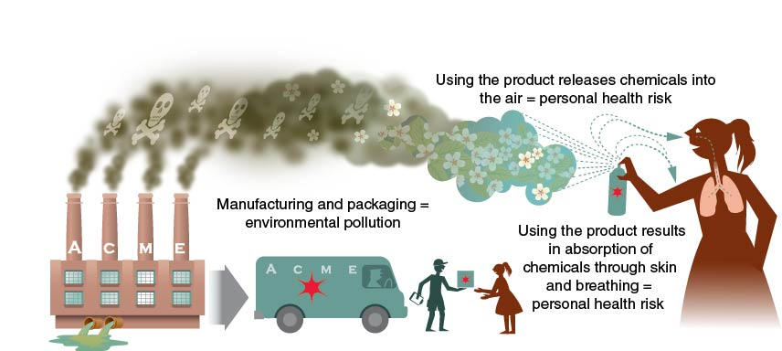
Why Chemicals Matter
Notes:
Figure 15.7 Chemicals are linked to both environmental and personal health risks.

Slide 6
Chemicals in Personal Care Products
Your body absorbs chemicals through your lungs and your skin when you breathe, bathe, eat, drink, and use personal care products.
Personal care products include shampoo, toothpaste, deodorant, sunscreen, and makeup.
A single product may have a chemical level that is considered safe, but the use of multiple products over many years may be dangerous.

Slide 7
Chemicals in Household Items
Household products and materials that we use to build our homes and communities can also contain toxic chemicals.
Examples include solvents, pool cleaners, paints, batteries, antifreeze, and insect and weed killers.
Groups most at risk are babies, young children, and pregnant women.

Slide 8
Getting Help When Needed
All products containing dangerous chemicals are labeled according to the danger they pose.
If you inhale or ingest a dangerous chemical, or your skin is exposed to a chemical, tell a doctor, school nurse, or trusted adult immediately.
Call the national Poison Control Center toll free at 800-222-1222 to ask for advice.
Be sure you know the name of the product or chemical.

Slide 9
Proper Disposal of Chemical Waste
Hazardous materials include all items that could cause damage to human or animal life or to the environment.
All products containing chemicals are labeled with instructions on proper disposal.

Slide 10
Skill-Building Challenge
Develop a short story about what you would do if you accidentally came into contact with a hazardous chemical.
The story should focus on what you should say and do in the situation.
Use the information from this chapter to build the details of your story so that it is accurate and results in a positive outcome.

