Slide 1
Conservation and Living Green
Live Well: Foundations of High School Health
Chapter 15, Lesson 3

Slide 2
Write About It
What does it mean to live green?
Do you think about the environmental impact of your daily life? Why or why not?

Slide 3
Can you . . .
Explain the five ways to protect the environment?
Provide two examples of commonly recycled products and what they are used for?
Explain what it means to live green and identify four related actions?

Slide 4
Conserving Natural Resources
Conservation refers to the steps people take to prevent the exploitation, destruction, or neglect of natural resources.
By conserving natural resources, we can help to preserve biodiversity.
Biodiversity refers to maintaining the balance of all living things (plants and animals) in an area.

Slide 5
Protecting the Environment
According to the EPA, there are five ways to protect the environment:
  Reduce
  Reuse
  Recycle
  Treat
  Dispose

Slide 6
Reduce
The most impactful way to protect the environment is to reduce the amount of trash and pollution we create in the first place.
  Focus on energy sources that create less pollution.
  Use renewable energy sources, a type of energy that will never run out (e.g., energy generated from the sun and wind).

Slide 7
Reuse
On average, each person in the United States produces five pounds of waste every day.
Strategies for reuse include the following:
  Try buying fewer items and reuse what you have.
  Reuse plastic shopping bags.
  Give clothing items you no longer want to someone who will use them longer.

Slide 8
Recycle (1 of 2)
Recycling is the process of collecting and processing materials that would otherwise be thrown away as trash and turning them into new products.
Recycling reduces the amount of trash that goes into landfills.
In most places, plastics, paper products, and glass are commonly recycled.
(continued)

Slide 9
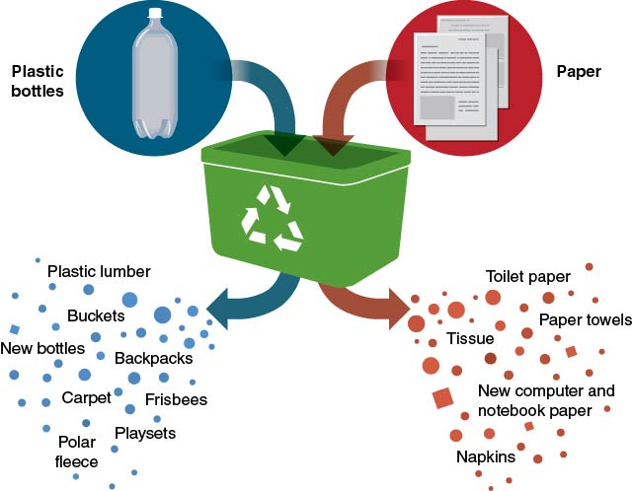
Recycle (2 of 2)
Notes:
Figure 15.11 What happens to commonly recycled items.

Slide 10
Treat
Treating substances that may be dangerous to the environment can protect people and the environment from the damage the substances cause.
Examples include treating
  contaminated water for safe use and
  contaminated land for future use.

Slide 11
Dispose
Dispose properly of materials that can’t be recycled or otherwise treated.
This includes
  not littering;
  properly disposing of items containing toxic or dangerous substances so that they don’t contaminate the water, soil, or air; and
  disposing of batteries at designated areas.

Slide 12
What Does Living Green Mean?
Living green means being aware of the effect your lifestyle and choices have on the environment.
A way to give back to the natural environment is to plant a tree.
Another way is to compost your food waste.
Composting involves placing food scraps and waste into outdoor bins for decomposition. The resulting compost can be mixed into the soil of a garden or yard.

Slide 13
Tips for Being a Green Student
Take notes electronically.
Carry a water bottle.
Use a reusable lunch bag.
Power down.
Recycle your paper.
Walk, bike, carpool, or use public transportation.
Take only what you’ll eat.

Slide 14
Being Green at Home
Reuse bags.
Buy less.
Borrow more.
Use energy-efficient light bulbs.
Save energy and sleep better.
Eat sustainable seafood.
Eat less meat.
Watch your water usage.
Buy eco-friendly products.

Slide 15
Skill-Building Challenge
This lesson provides you with examples of ways you can live green.
Select three to five ideas presented in the lesson and try to do them consistently over a week or longer. Select ideas that you value and that are realistic.
Write down your choices and create a log to track your progress.

